Slide 1
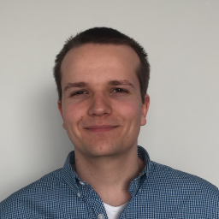
MagnaData: Scheduling Complex Workflows with Non-Functional Requirements in Datacenters
Laurens Versluis
Massivizing Computer Systems
@Large research
https://atlarge-research.com

Slide 2






@Large Research
Massivizing Computer Systems
20+ researchers spanning VU Amsterdam & TU Delft
Close collaboration with partners
Goal: valorize our research; improve our society
Notes:
Before we dive into the details, let’s first place this work in a larger context by spending a few words on the @Large research group. @Large Research is a research group that focuses on Massivizing computer systems, which I will cover in a minute.
Our team consists of more than 20 researchers across both the VU Amsterdam and the TU Delft
We like to work closely with our partners such as the SPEC cloud group, the University of Wurzburg and industrial partners such as Google and Intel, where one of our goals is to valorize our research; get it used by society

Slide 3

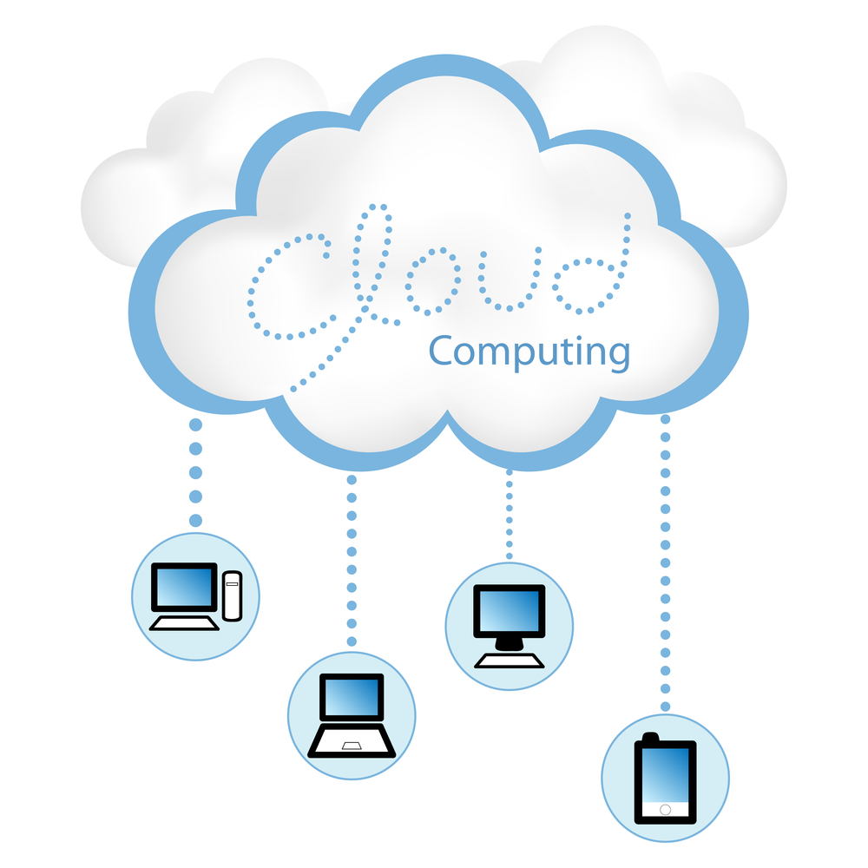



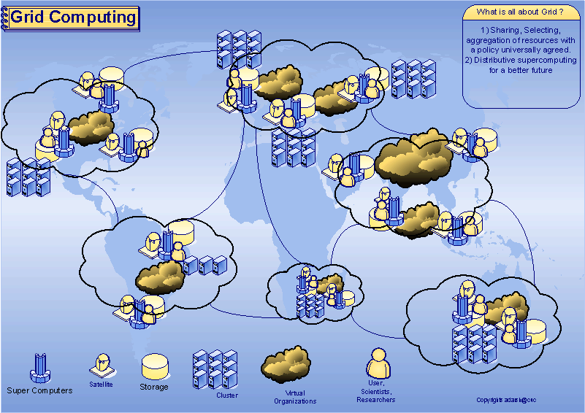
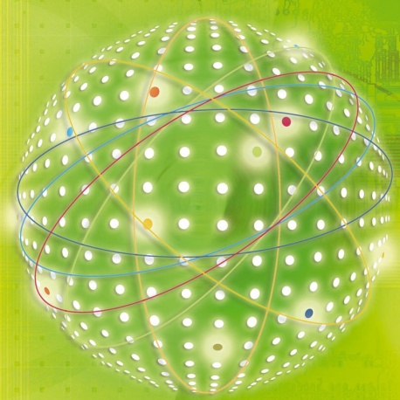
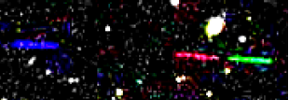


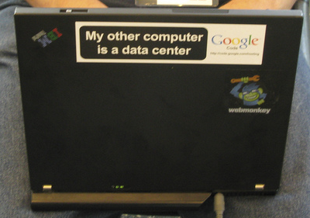
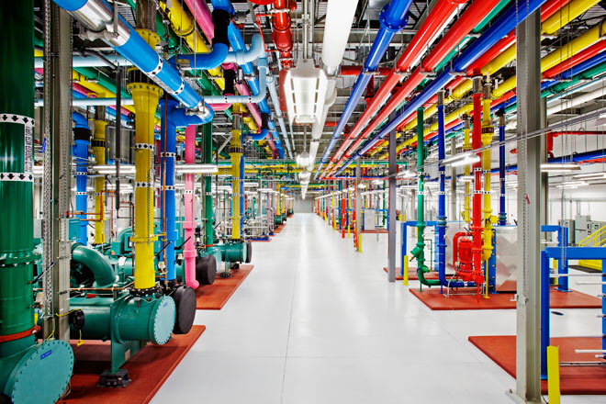

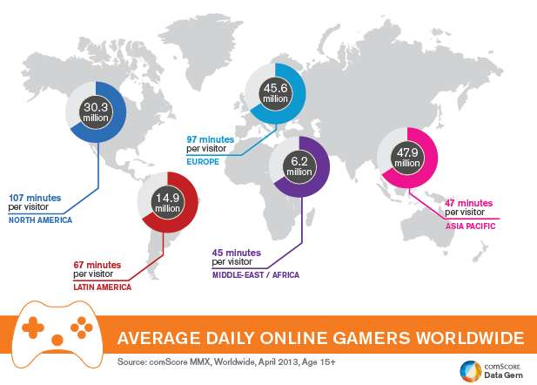




Massivizing Computer Systems
Business Services
Education for Everyone (Online)
Grid Computing
Big Science
Online Gaming
Datacenters
Daily Life
Notes:
Massivizing Computer Systems focuses on large systems that impact society, ranging from education to datacenters and from Big Science to Online gaming.
In this talk, we will mainly focus on this components <click> Cloud computing. (next slide… Because cloud popularity and its usage….)

Slide 4
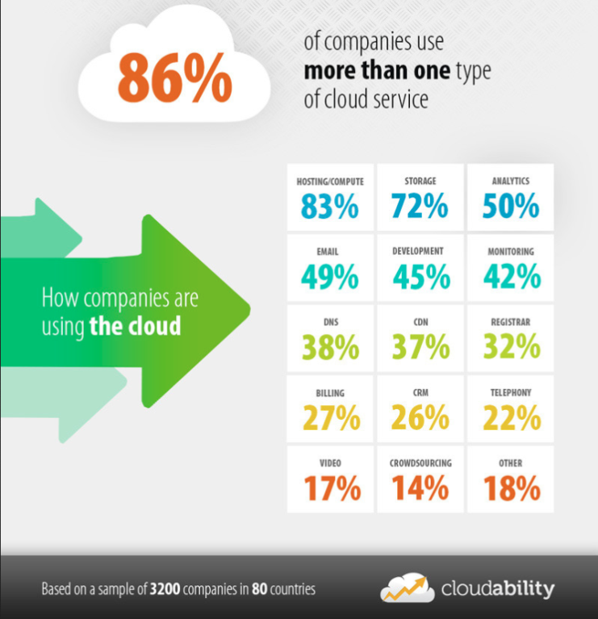
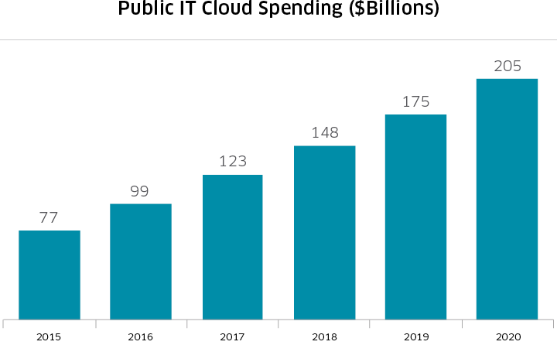
Cloud popularity and usage at all-time high
Surveys: 86% of companies use >1 cloud service, >$200B market by 2020
Efficient resource utilization increasingly important
  Reduce costs for client & provider
  Competitive position for companies
Source: http://business.nasdaq.com/marketinsite/2017/Cloud-Computing-Industry-Report-and-Investment-Case.html

Slide 5
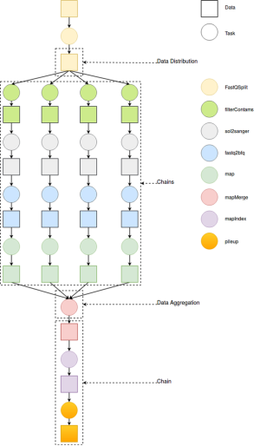
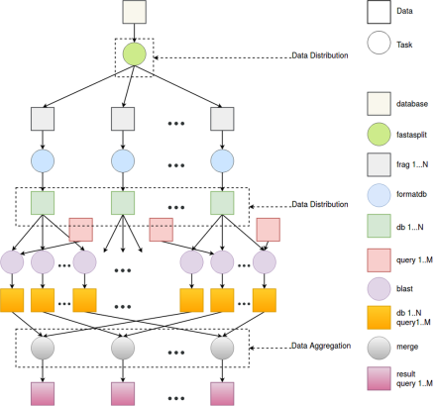

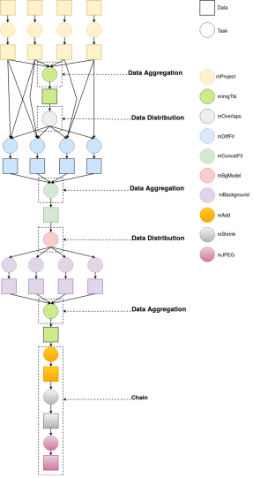
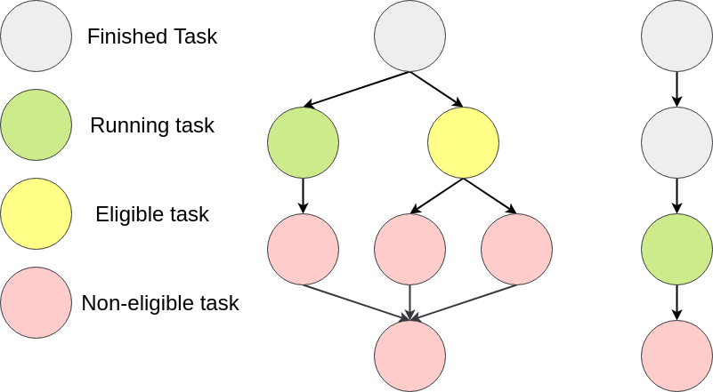


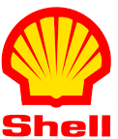
Workflow execution is popular
Workflows = set of tasks with precedence constraints
  Usually represented as a Directed Acyclic Graph (DAG)
  Used to model applications in many domains
Today: thousands of applications in use

Slide 6
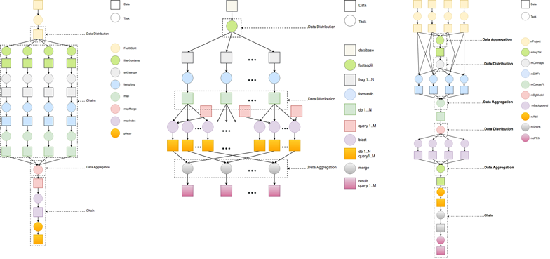
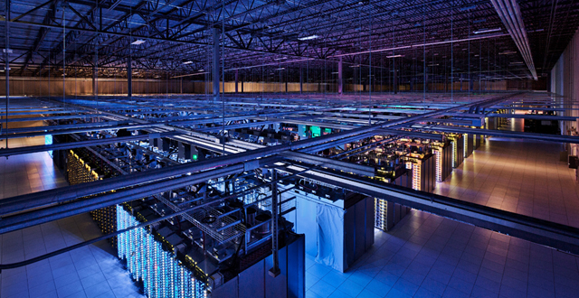
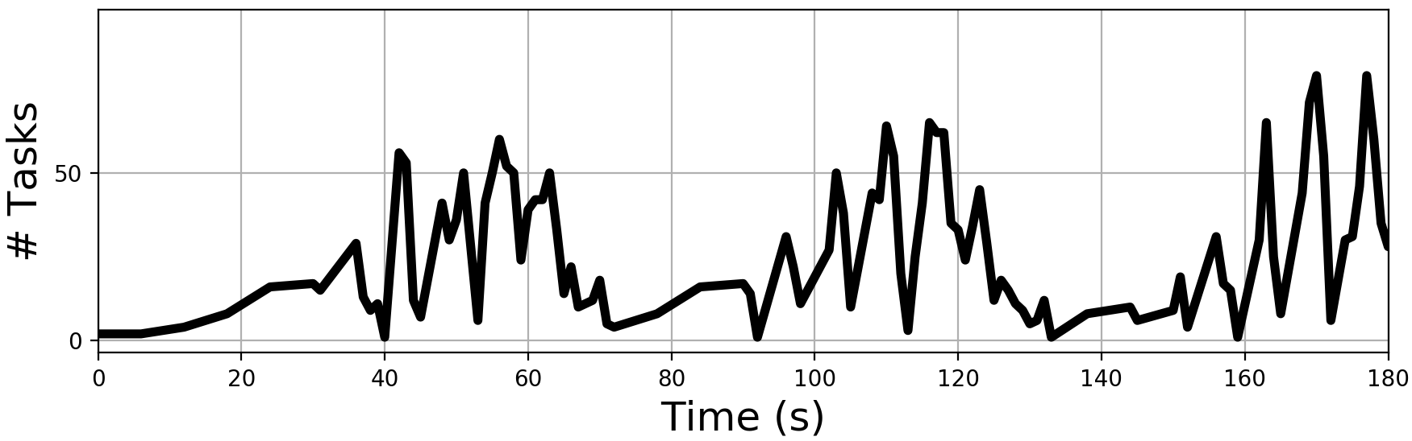
Executing workflows in the cloud
Workflows are submitted to the cloud, executed in datacenters
Workflow resource demand changes over time due to their complex structures
Non-trivial to efficiently schedule incoming workloads of workflows and allocate enough resources
How many resources to acquire and when?
Workload of workflows

Slide 7
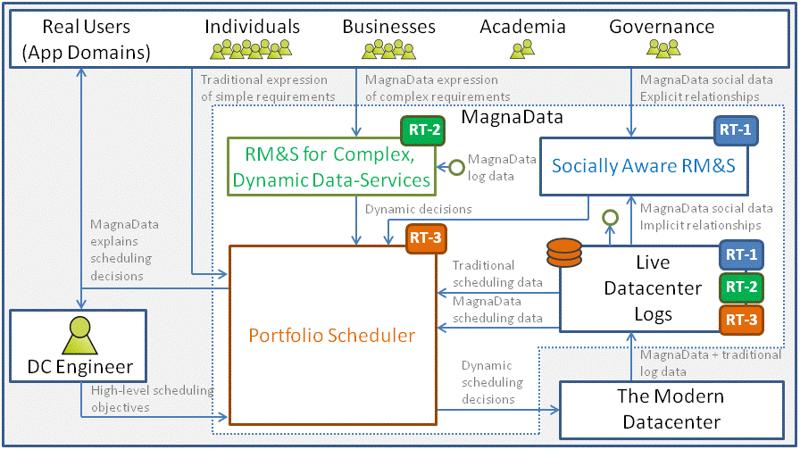
The MagnaData Project: Overview

Slide 8

Challenges of scheduling in clouds
Schedule tasks as efficiently as possible
  Which machine to put the task on?
Allocate resources to keep up with demand
  When to allocate which machine (size, resources)?
Adhere to the Quality-of-Service (QoS) requirements of the client
  Incur a penalty otherwise
Automate this process
  To avoid e.g. poor user estimates

Slide 9
RM&S for Complex, Dynamic Data-Services
  Goal: The first comprehensive RM&S for cloud datacenters with per-component changes of performance and availability requirements.
  Four important concepts:
Allocation & Provisioning policies
  How to efficiently schedule tasks?
  When to allocate a new machine?
  Etc.
Fine granularity (task-based)
Non-functional requirements
  How to specify NFRs?
  How to enforce them?
  What is the minimal specification required to enforce?
Dynamic changes
CCGrid’18:
Compare eight provisioning policies (autoscalers)
HotCloudPerf’18:
Investigated three workflow formalisms on their NFR support

Slide 10



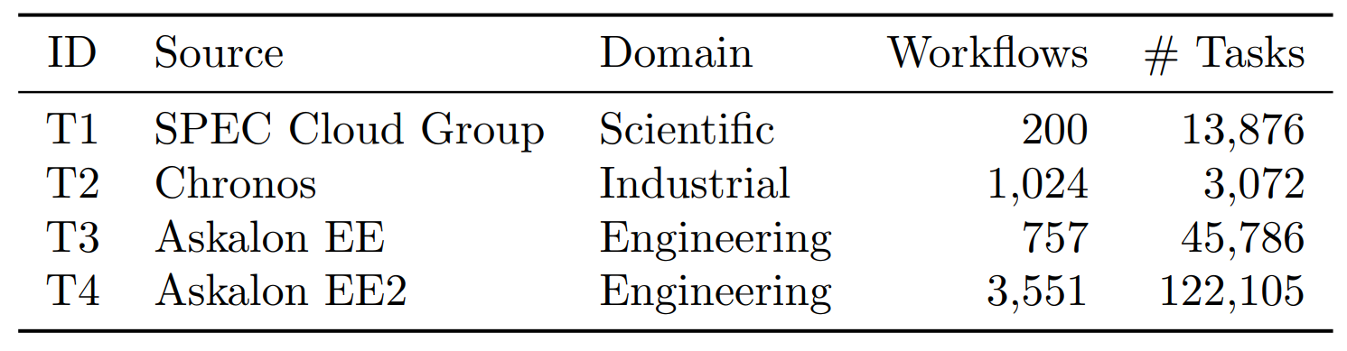
CCGrid’18: Compared 8 autoscalers in simulation
Four distinct workload traces
  A workload is a set of workflows (applications)
Use a rich set of metrics
  10+ forms of elasticity
Four experiments
  Different workload domains (new)
  Bursty workloads (deeper understanding)
  Impact of the allocation policy (new)
  Different resource environments (new)

Slide 11
HotCloudPerf’18: Formalisms for workflows with non-functional requirements
Surveyed 116 papers from across 11 venues
Investigated three most popular workflow formalisms
  DAG
  BPMN
  Petri net
Main findings:
No formalism is capable of specifying arbitrary non-functional requirements at the task level
DAGs look the most promising to extend

Slide 12
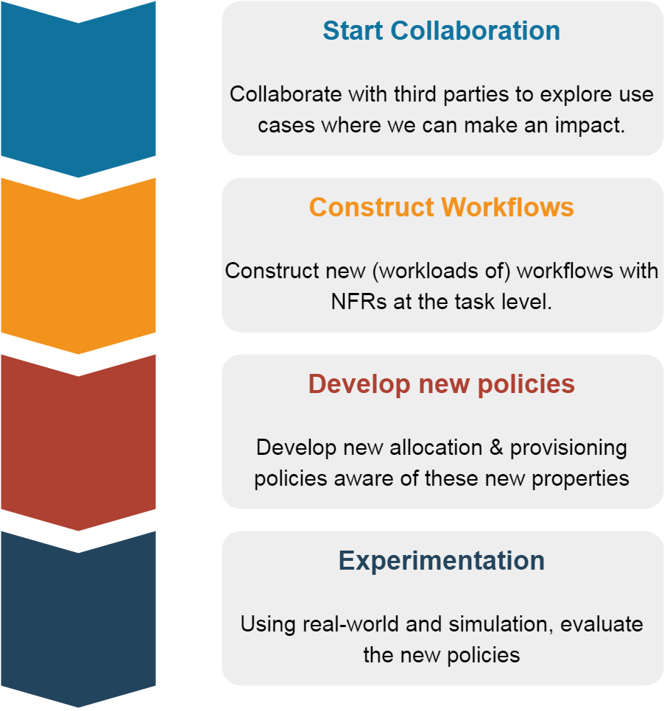
Roadmap

Slide 13
Conclusion and ongoing work
Main take-away message:
The MagnaData project focuses on improving efficiency of scheduling in clouds.
My work focuses on:
Introducing task-based NFR
Devise new allocation & provisioning policies
Valorisation: collaborate with third parties
Interested in this work? Let me know!
Laurens Versluis
Massivizing Computer Systems
@Large research,
https://atlarge-research.com
Notes:
The performance differs significantly per application domain
All autoscalers perform similar on bursty workloads in terms of NSL
The allocation policy has a direct impact on performance
Suggests to co-design allocation and provision policies
Some autoscalers overprovision more while yielding no better NSL

Slide 14
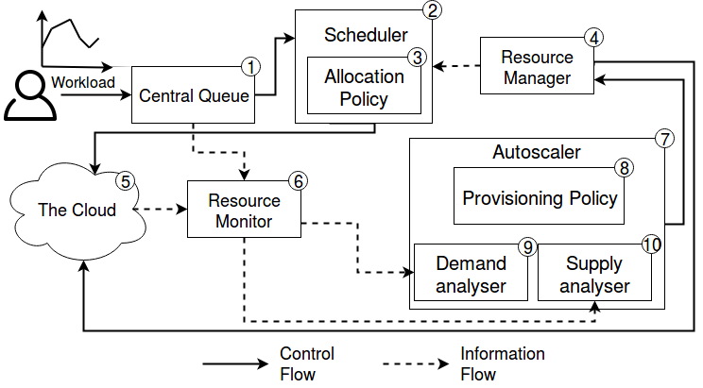
Cloud architecture overview

Slide 15
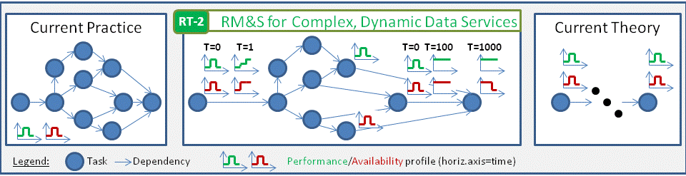
The current approach

Slide 16
