Slide 1
Opencraft
A benchmark for Minecraft-like services
Jerom van der Sar
Jesse Donkervliet
Alexandru Iosup
Contact: opencraft@atlarge-research.com www.atlarge-research.com/opencraft

Slide 2
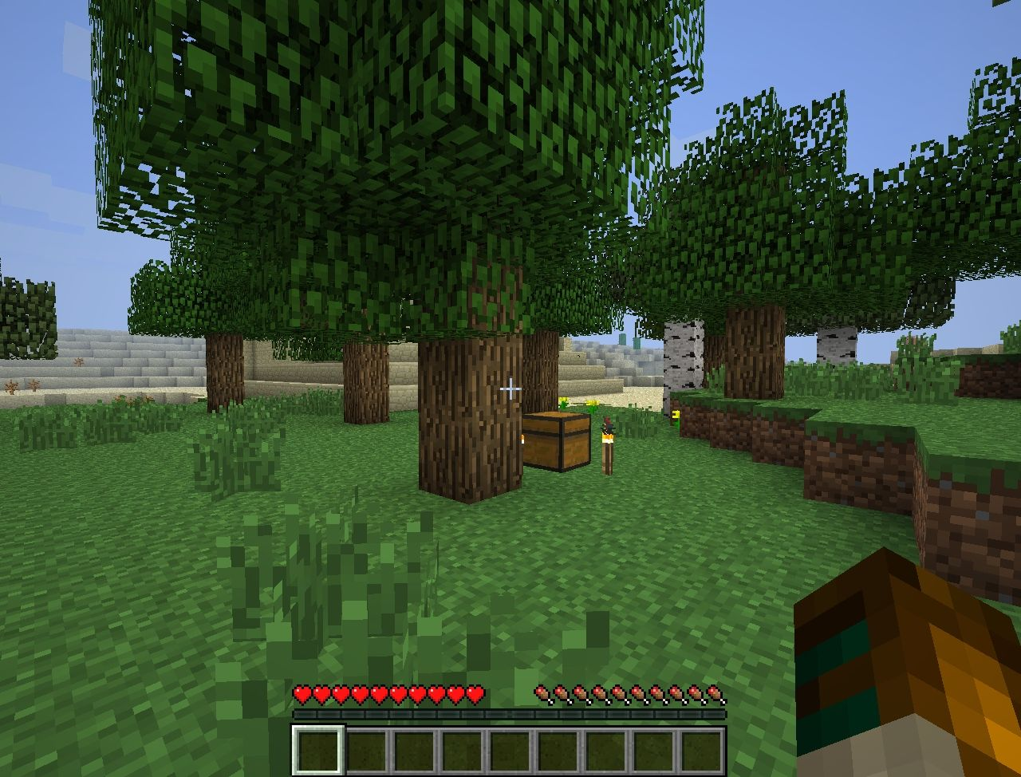
Minecraft = Block-based Online Game
Blocks
© Mojang and Microsoft
Notes:
Talk about Minecraft
Differences between MC and other games
Introduce: example awesomeness
Hint about computation: dynamic pathfinding in Minecraft

Slide 3
Minecraft = Most Popular Block-based Online-game
50 million active users
Over 100 million sales worldwide
53,000 daily
20 since this presentation started
Mojang valued at $1.8 billion, bought for $2.5 billion
38,000 modules for 10+ platforms
Sources: techspot.com, curseforge.com

Slide 4
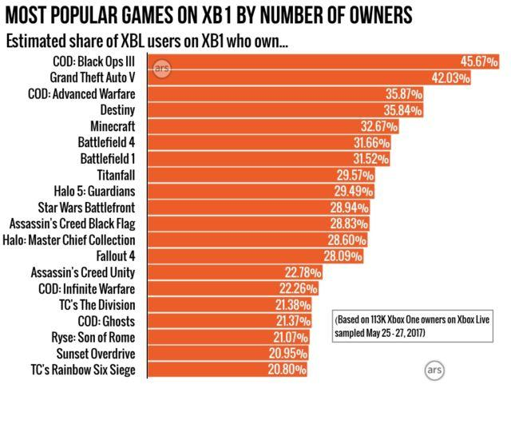
Minecraft = Most Popular Block-based Online Virtual Environment
Also: Only game in top-20 by sales for Nintendo Wii/Switch
Source: arstechnica.com
Notes:
Number 5 most bought game on Xbox 1. One in three Xbox users have Minecraft.

Slide 5
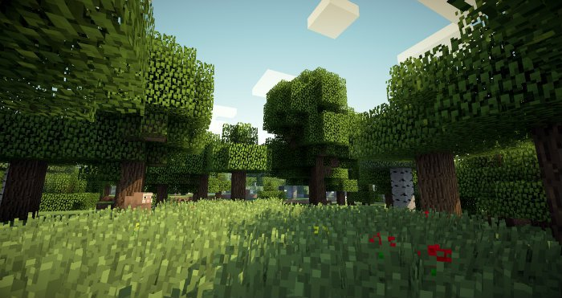
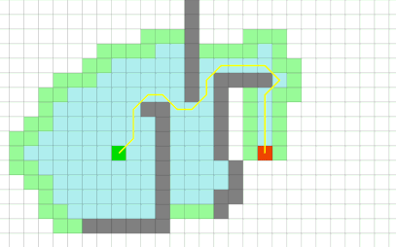
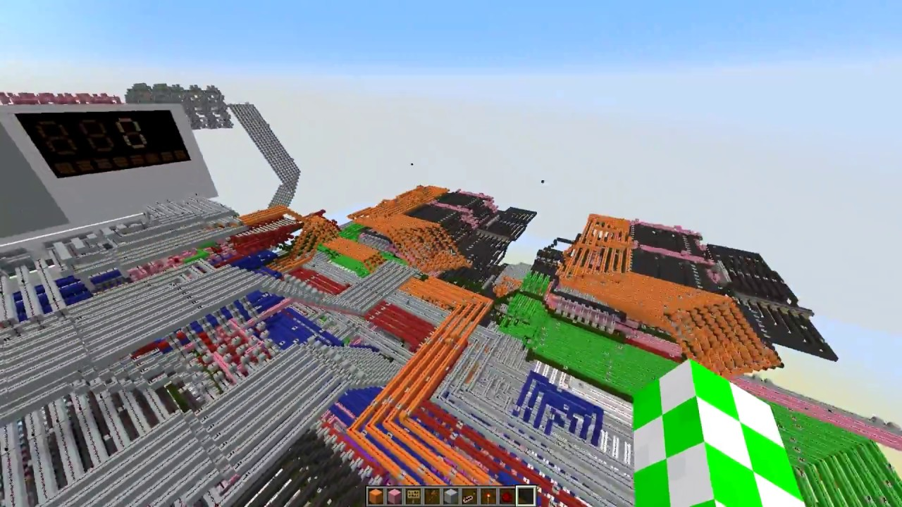
Minecraft = Uniquely Modifiable Online Game
1. Terrain is completely modifiable
No baked lighting / light maps
Unstable 3D pathfinding
No static maps ⇒ More network
2. Terrain influences computation
Redstone ⇒ Computation in MC
Physics ⇒ Falling blocks, liquid flow, arrows, etc.
Sources:
curseforge.com,
codingame.com,
minecraftsix.com

Slide 6
Community hosts 50k+ servers on 10+ distributions
Minecraft servers:
2. Minecraft offered ‘as a Service’
Officially: Mojang Realms
Unofficially: 50+ providers
Sources: bstats.org
Notes:
1. Minecraft is important because
2. What is the ‘best’ Minecraft server:
For lots of people
Works consistently

Slide 7
Which Minecraft-like Server Performs ‘Best’?
Community hosts 50k+ servers on 10+ distributions
Minecraft servers:
2. Minecraft offered ‘as a Service’
Officially: Mojang Realms
Unofficially: 50+ providers
Q: How to evaluate the scalability of Minecraft-like games?
Q: How to make Minecraft-like games scale to millions?
Sources: bstats.org
Notes:
1. Minecraft is important because
2. What is the ‘best’ Minecraft server:
For lots of people
Works consistently

Slide 8
Opencraft: An Umbrella Project
Yardstick
A benchmark for Minecraft-like services
Meerkat
A prototype to explore novel scalability techniques for Minecraft
Notes:
Note: Opencraft only _starts_ with these two subprojects.

Slide 9
Yardstick
A Benchmark for Minecraft-like Services

Slide 10
Yardstick: Goals
Performance evaluation tool for Minecraft-like games
Goals:
Benchmark & compare server performance: Which architecture and/or implementation for Minecraft-like games performs ‘best’?
Analyze server performance: Identify bottlenecks and performance issues

Slide 11
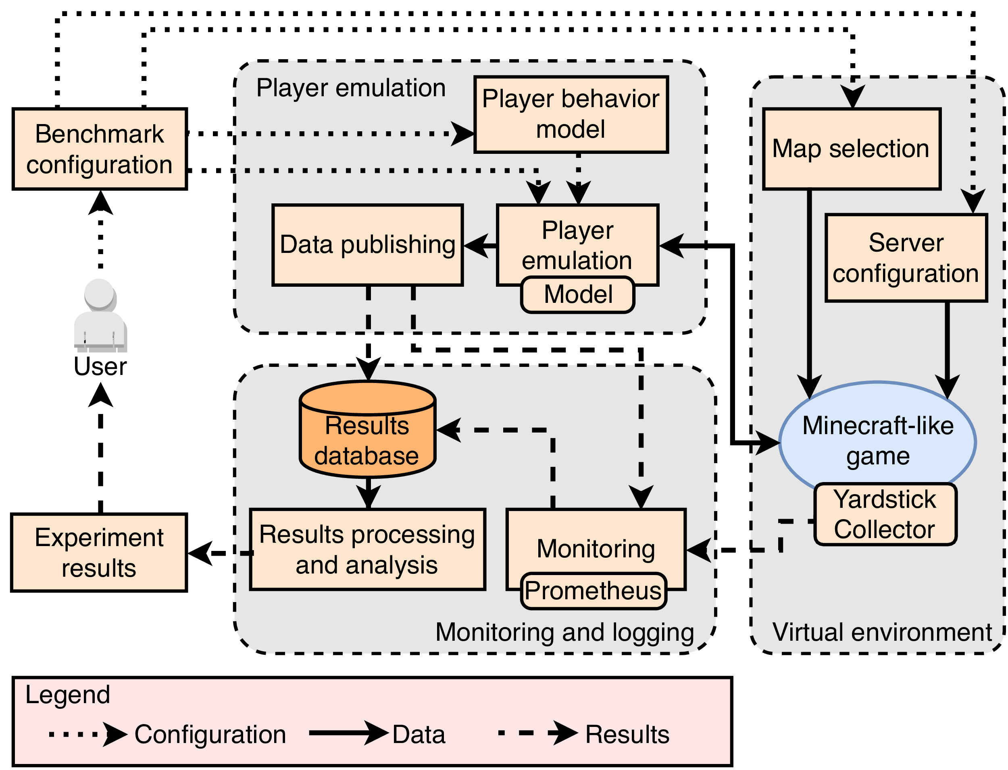
Yardstick: Design Overview
Notes:
Talk about
Player emulation
Vendorized Minecraft server
Results processing and virtual environment

Slide 12
Yardstick: Experimental Setup
Experiments performed on DAS-5
1 node: Minecraft server
5 nodes: Yardstick player emulation
1 node: Monitoring
Workload consist of players that alternate between traveling (walking a large distance)
and interacting (walking many short distances)

Slide 13
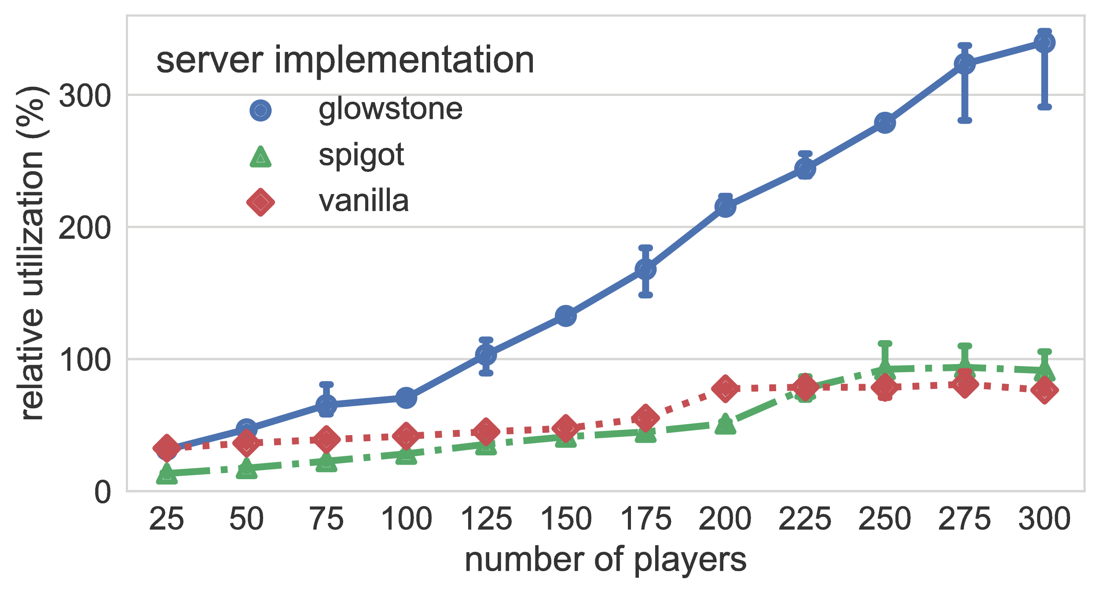
Yardstick: Latest Results (1/3)
≈ 100% tick utilization
Notes:
Talk about
Player emulation
Vendorized Minecraft server
Results processing and virtual environment

Slide 14
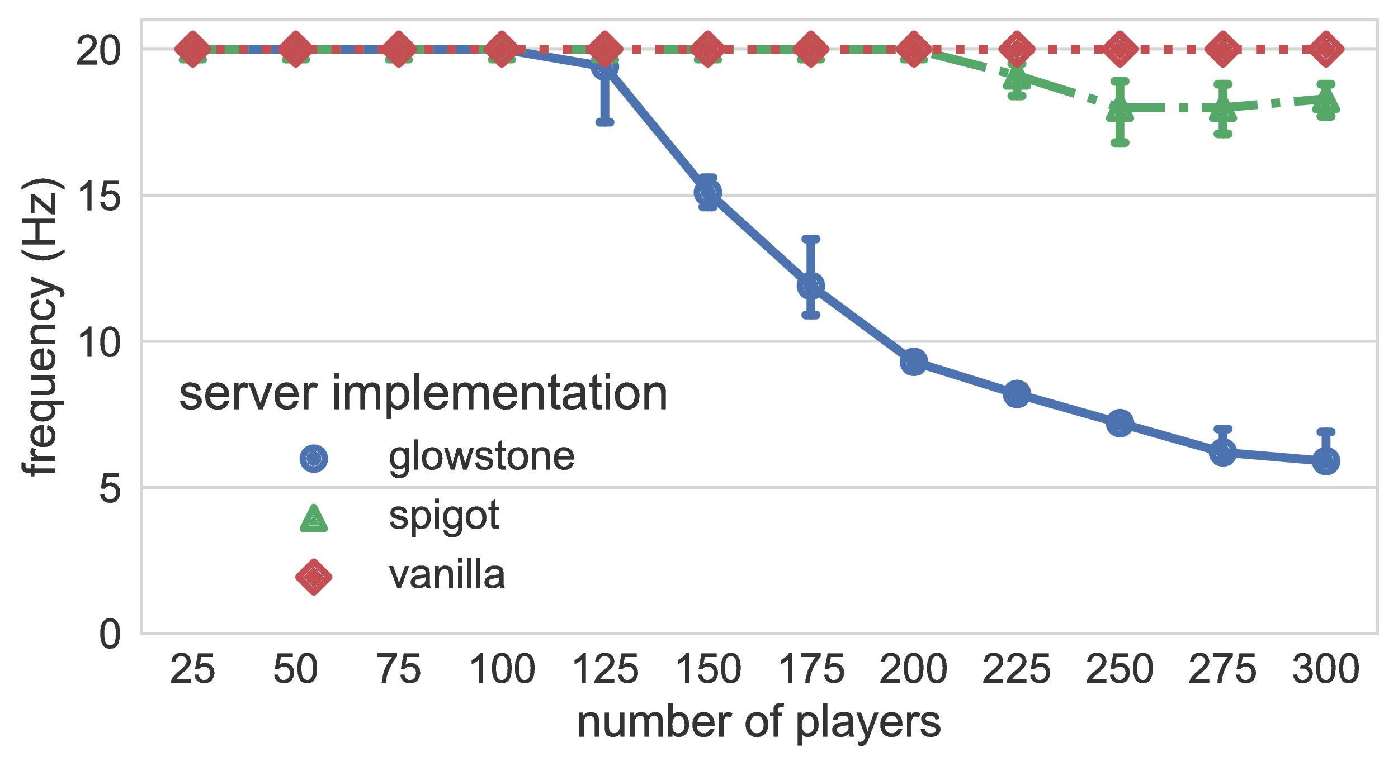
Yardstick: Latest Results (2/3)
≈ 125 players
Notes:
Talk about
Player emulation
Vendorized Minecraft server
Results processing and virtual environment

Slide 15
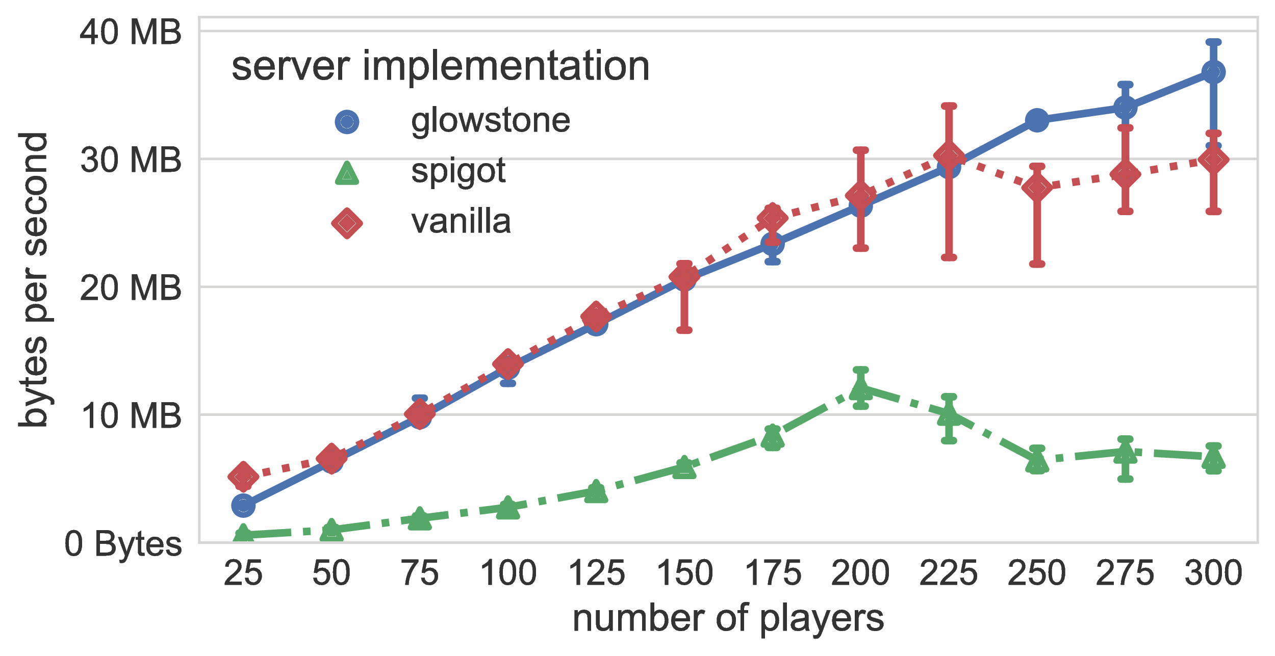
Yardstick: Latest Results (3/3)
≈ 160 Mbps outgoing
Notes:
Talk about
Player emulation
Vendorized Minecraft server
Results processing and virtual environment

Slide 16
Meerkat
A Prototype to Explore Novel Scalability Techniques for Minecraft

Slide 17
Meerkat: Improving Scalability by Reducing Communication
large number of players
complex world
high amount of communication
+
Notes:
We now want to focus on improving the scalabiltiy.
Complex environment → Increased communication
Highest impact: world data

Slide 18
Meerkat: Improving Scalability by Reducing Communication
large number of players
complex world
allowing bounded inconsistency
reduced amount of communication
Challenge: be inconsistent without impacting player experience
+
Notes:
Solution: Introduce inconsistency to improve performance without UX drop

Slide 19
Meerkat: Using the Conit Consistency Model
Quantify inconsistency in the system using three metrics
Staleness (how old is this update?)
Numerical error (how large is the impact of this update?)
Order error (how does this update relate to other updates?)
Notes:
Conits: use three dimensions to model (in)consistency
Example: Far explosives have a large numerical error
If someone blows up the casle, it really matters

Slide 20
Consistency Example: Current Approach
Tick: 1
Server
Client

Slide 21
Consistency Example: Current Approach
Tick: 2
Server
Client
Server receives update

Slide 22
Consistency Example: Current Approach
Tick: 3
Server
Client
Update sent to client

Slide 23
Consistency Example: Current Approach
Tick: 4
Server
Client

Slide 24
Consistency Example: Current Approach
Tick: 5
Server
Client

Slide 25
Consistency Example: Current Approach
Tick: 5
Server
Client

Slide 26
Consistency Example: Conits
Tick: 1
Numerical Error Bound: 3
Server
Client

Slide 27
Consistency Example: Conits
Tick: 1
Numerical Error Bound: 3
Server
Client
Error = 1

Slide 28
Consistency Example: Conits
Tick: 2
Numerical Error Bound: 3
Server
Client
Error = 2

Slide 29
Consistency Example: Conits
Tick: 3
Numerical Error Bound: 3
Server
Client
Error = 3

Slide 30
Consistency Example: Conits
Tick: 4
Numerical Error Bound: 3
Server
Client
Error = 0

Slide 31
Meerkat: Experimental Setup
Experiments performed on DAS-5
Varying …
… number of nodes
… consistency bounds
Workload of 100% writes (heaviest workload possible)

Slide 32
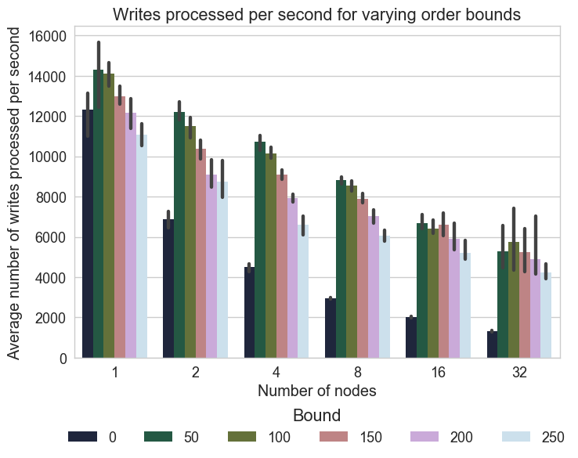
Meerkat: Initial Results
Notes:
Core message: between 0 and 50ms → clear improvement in throughput

Slide 33
Wrapping Up

Slide 34
Opencraft: Future Work
Yardstick
Realistic player emulation based on real-world message dumps
Support for all major server implementations
Complex interactions with the virtual environment
Meerkat
Evaluate scalability improvements …
… when dynamically changing consistency bounds
… when using realistic (server-client) network setups
… when using realistic workloads
Notes:
Meerkat:
→ Dynamic bounds
→ Multi-hop conits
→ Realistic workloads

Slide 35
Take-Home Message
Minecraft server scalability varies across implementations
Improved performance with (dynamic)
conits is promising

Slide 36
Talk to us at these places:
Opencraft
@Large Research
Delft University of Technology & Vrije Universiteit Amsterdam
www.atlarge-research.com/opencraft
opencraft@atlarge-research.com
Jerom van der Sar
J.vanderSar@atlarge-research.com
Jesse Donkervliet
J.Donkervliet@atlarge-research.com
(So long, and thanks for all the fish)

Slide 37
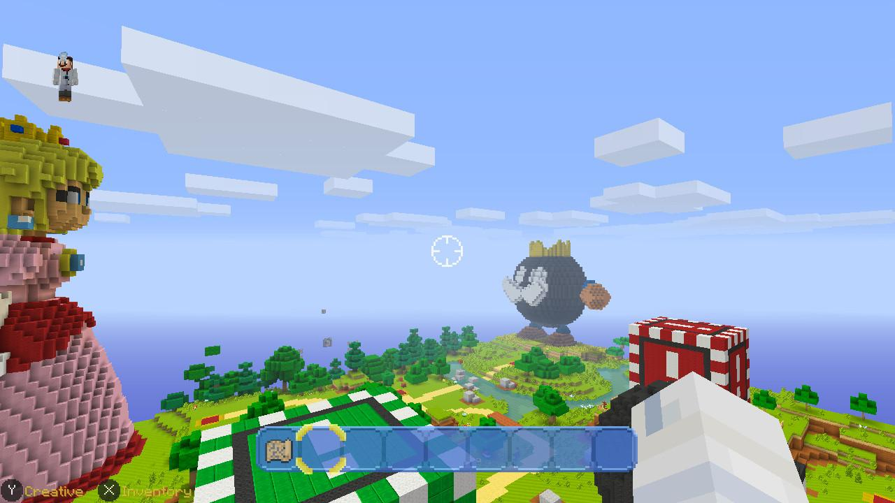
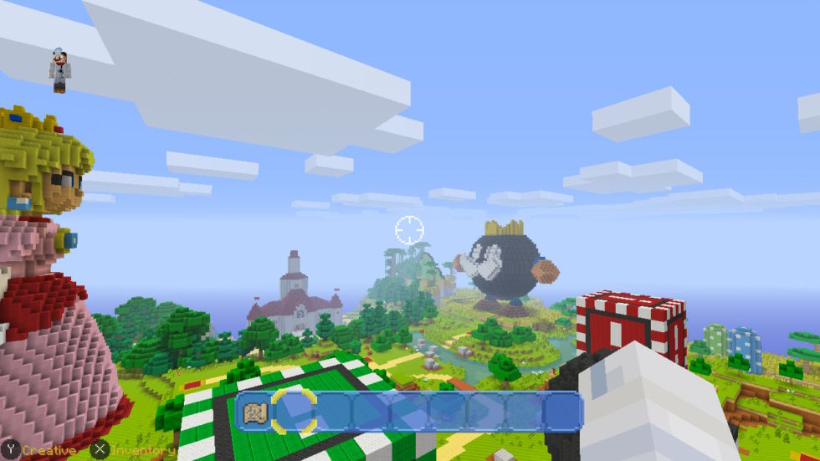
Minecraft = Subject to Performance Optimization
Undocked (Battery)
Docked (A/C)
Minecraft on Wii Switch: docked (A/C) vs undocked (Battery)
Source: techspot.com
Notes:
Minecraft on Wii switch: docked vs undocked.

Slide 38
Meerkat: Using the conit consistency model
A conit is a consistency unit, where:
1 conit = subset of game data + tolerated inconsistency
Notes:
Introduce conits to reduce consistency.

Slide 39
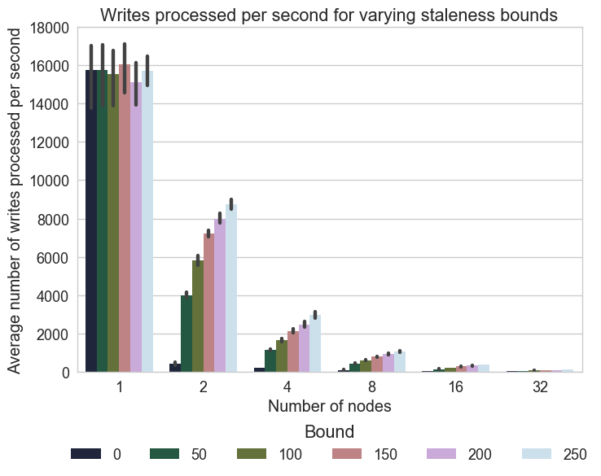
Meerkat: Initial Results

Slide 40
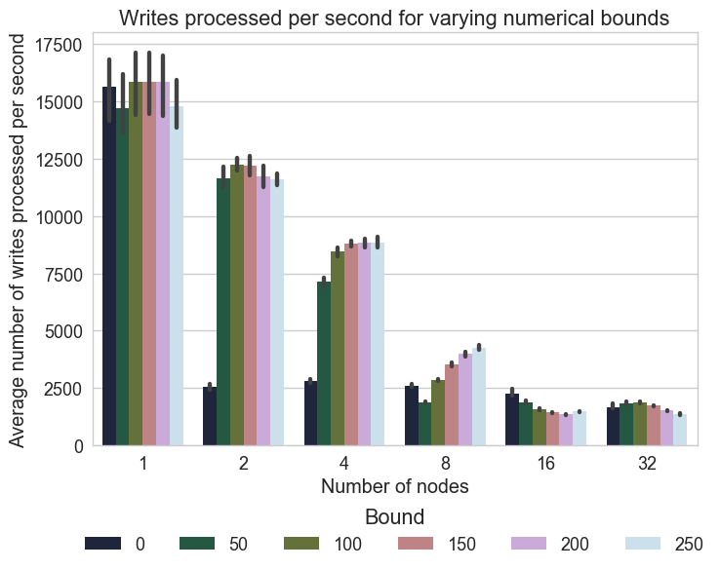
Meerkat: Initial Results

