Slide 1

Higher Education in Computer Systems
Using gamification to train the next generation computer scientists
Jesse Donkervliet
Twitter: @jdonkervliet
Email: J.Donkervliet@atlarge-research.com

Slide 2
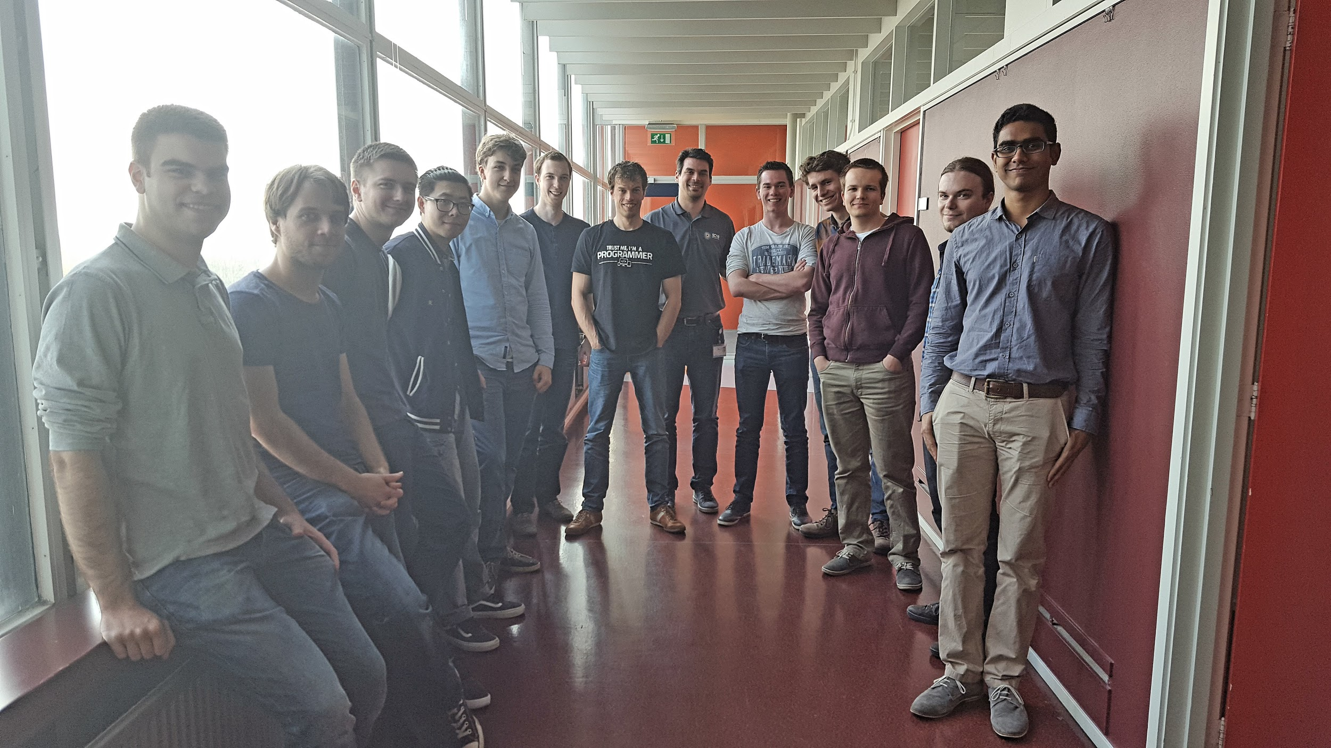
That’s me!

Slide 3
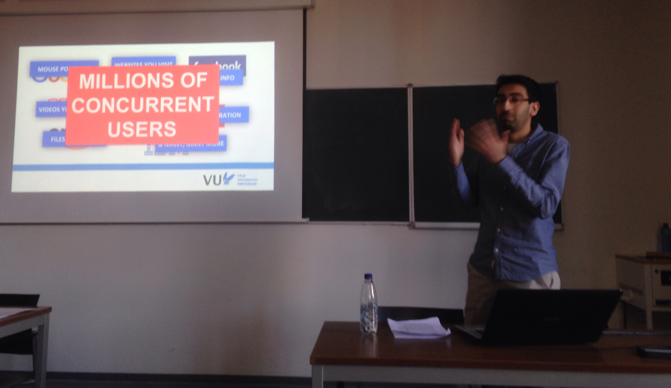
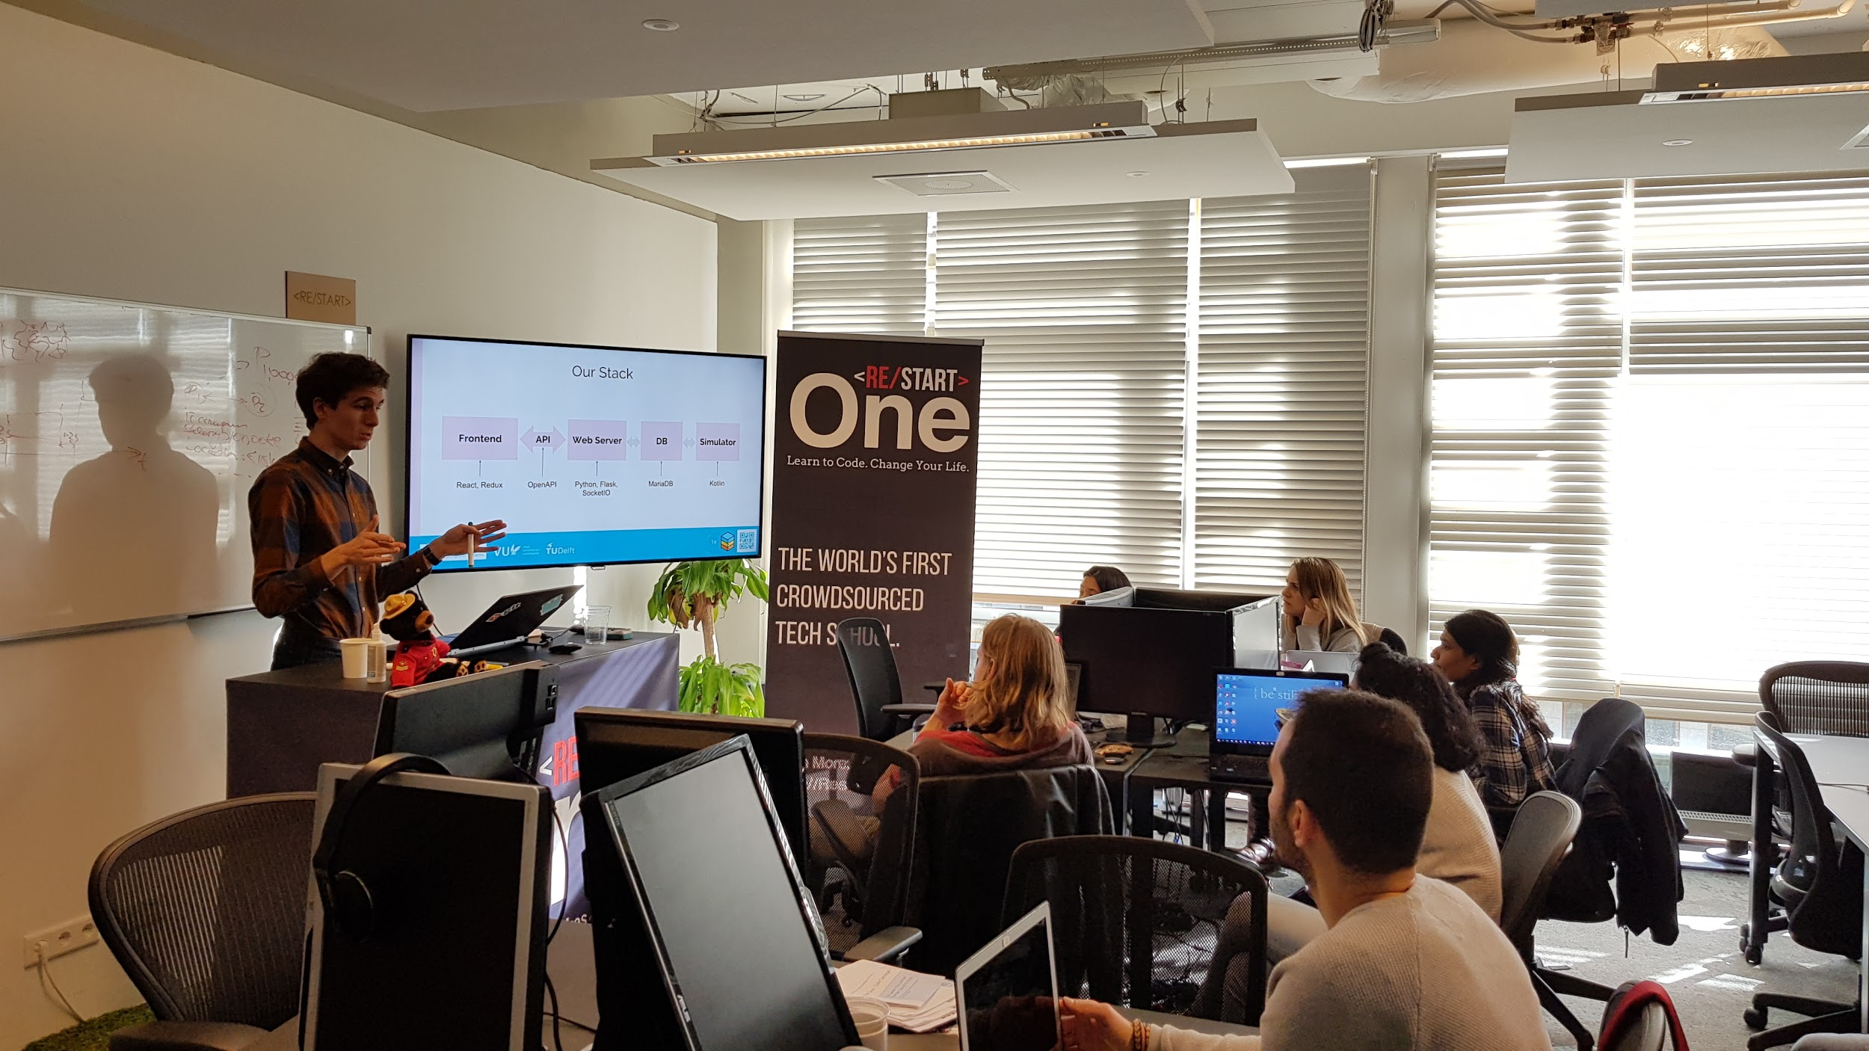
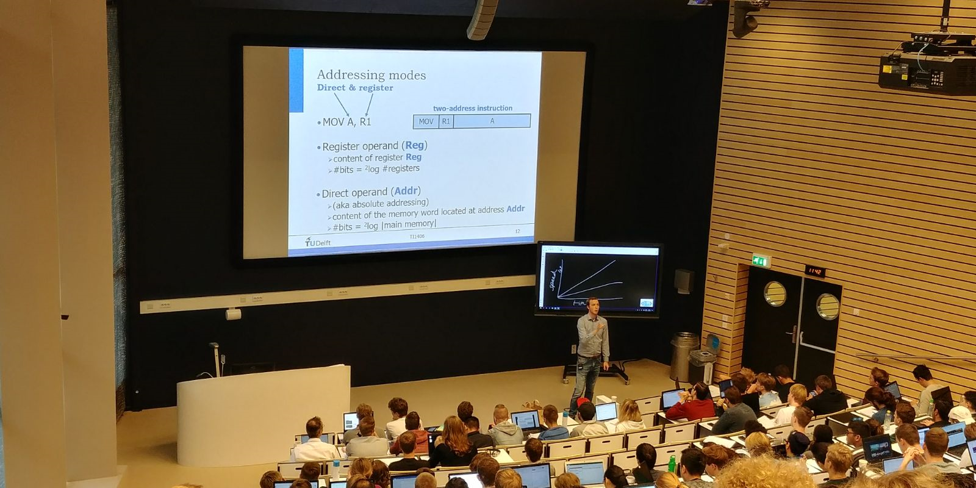
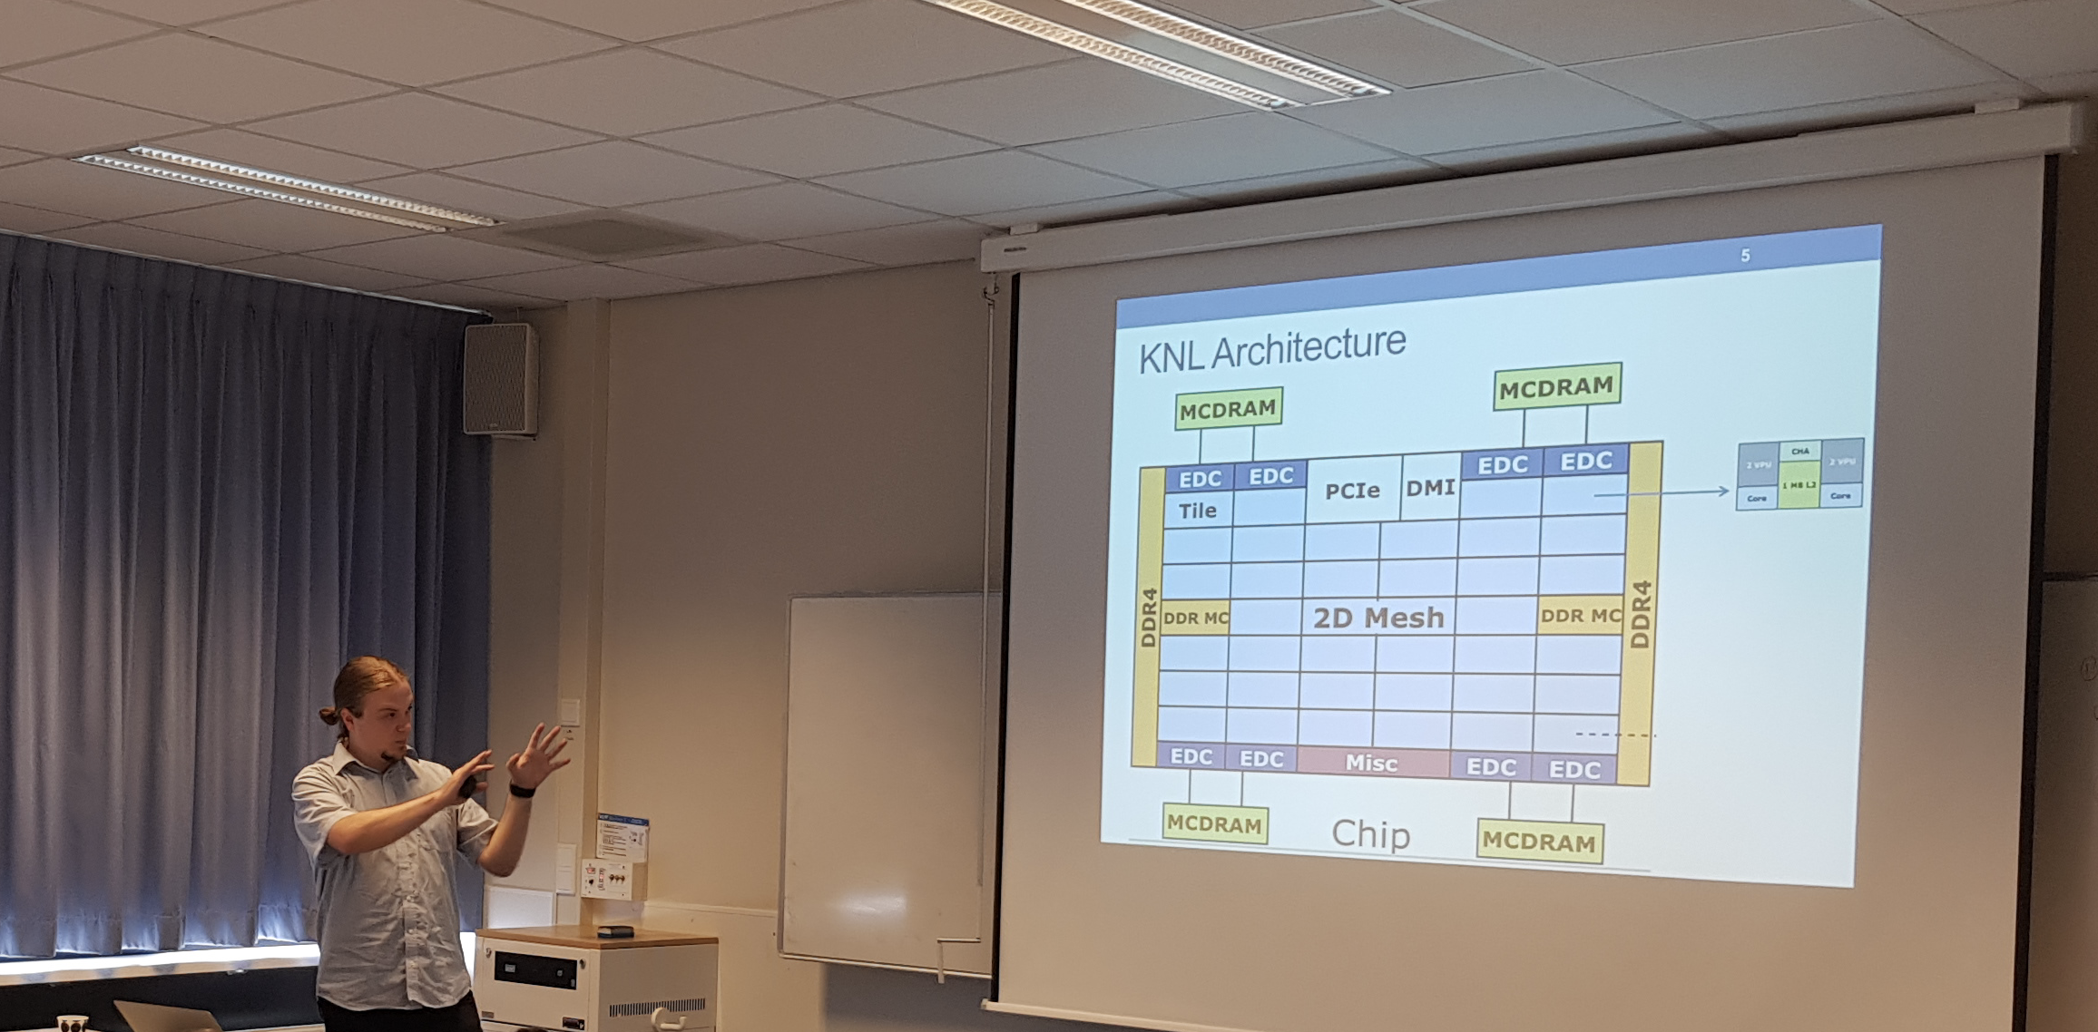
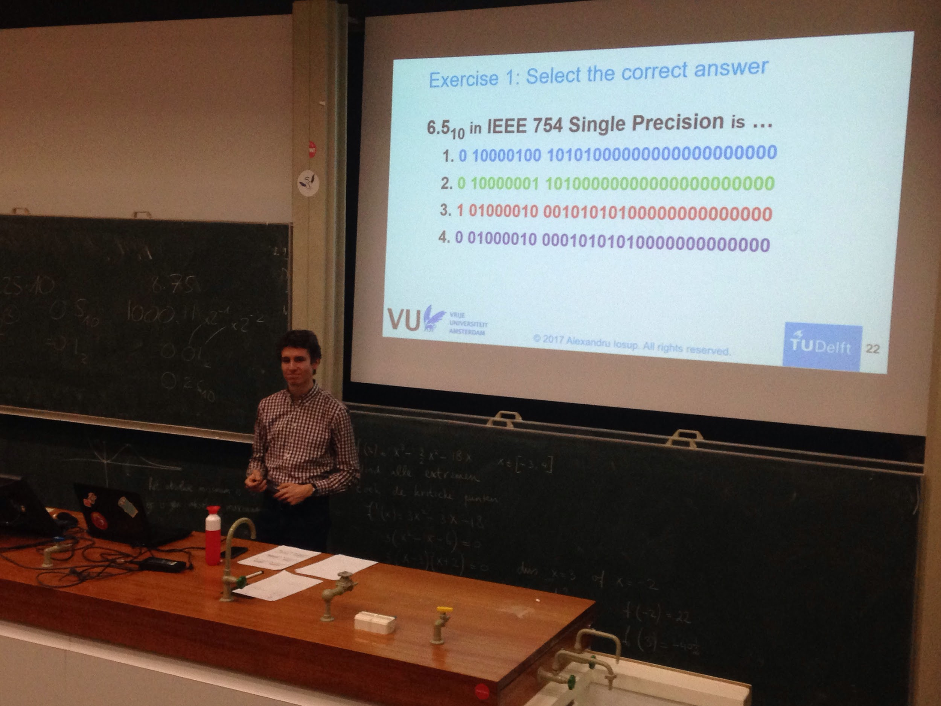
Teaching the next generation computer scientists
We teach in the bachelor, master, and elsewhere.
Notes:
A lot of research, but also education!

Slide 4
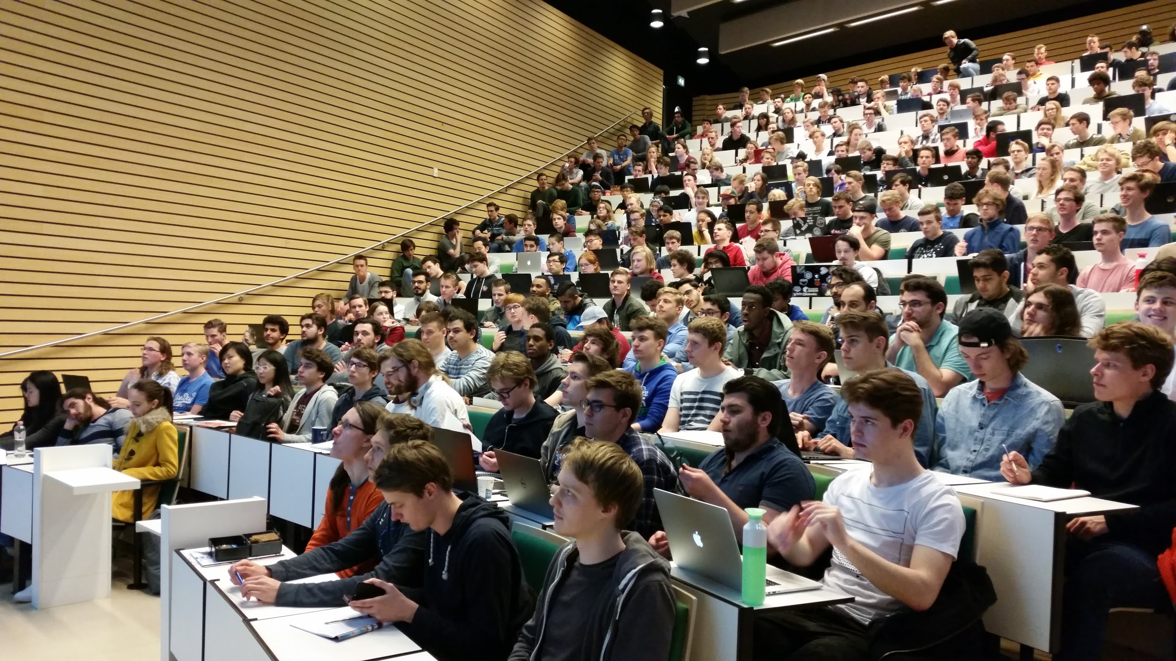
How to teach diverse groups?
How to address different skill levels and interests?

Slide 5


Traditional course design
The path of advancement for a traditional course.
Week 1
Week 2
Week 3
Week 4
Week 5
Week 6
Week 7
Week 8
time
Notes:
What do you want to offer in your course

Slide 6

Some students want to explore.

Slide 7
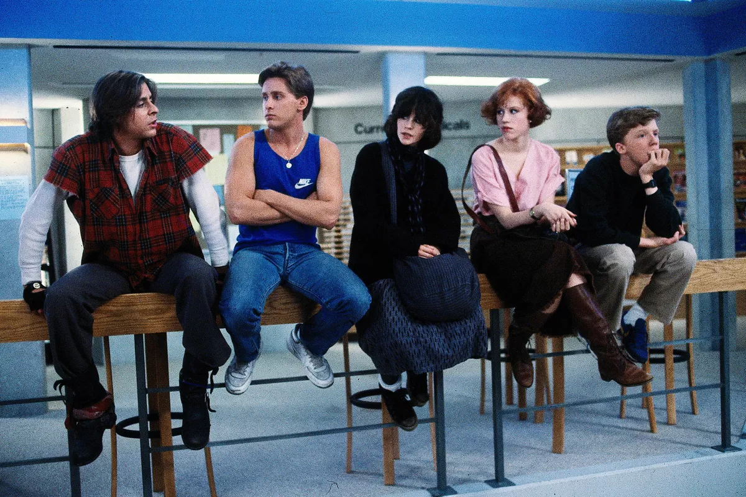
Some students want to socialize.

Slide 8

Some students want to win.

Slide 9

Traditional course design
Assignments and exams calibrated to pass the average student.
= average difficulty
Week 1
Week 2
Week 3
Week 4
Week 5
Week 6
Week 7
Week 8
time
Notes:
What do you want to offer in your course

Slide 10
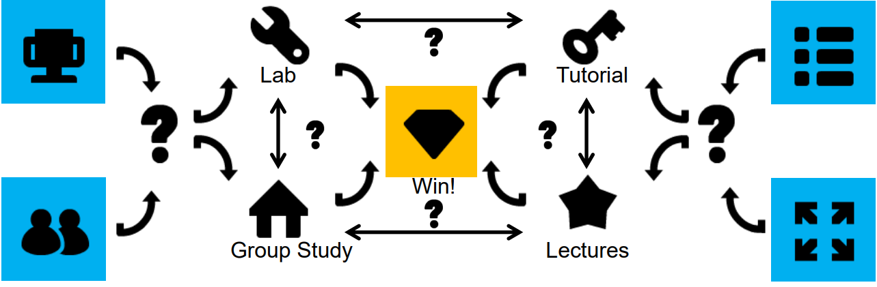
Gamified course design
Creating a course is like creating a complex puzzle!
Notes:
We use gamification

Slide 11
Traditional course design
Assignments and exams calibrated to pass the average student.
= average difficulty
Week 1
Week 2
Week 3
Week 4
Week 5
Week 6
Week 7
Week 8
time
Notes:
What do you want to offer in your course

Slide 12
Gamified course design
Multiple paths available for students with different skill levels and interests.
Open ended assignment
Competition
Week 1
Week 2
Week 3
Week 4
Week 5
Week 6
Week 7
Week 8
time
Notes:
What do you want to offer in your course

Slide 13

Open ended assignment
Competition
Week 1
Week 2
Week 3
Week 4
Week 5
Week 6
Week 7
Week 8
time
Notes:
Activities we use in practice
Lab
Lab bonus assignments: game, interpreter competition, medium access control simulator, TELNET RFC
Self study
Tutorials
But also:
In-lecture questions
In-lecture quizzes

Slide 14
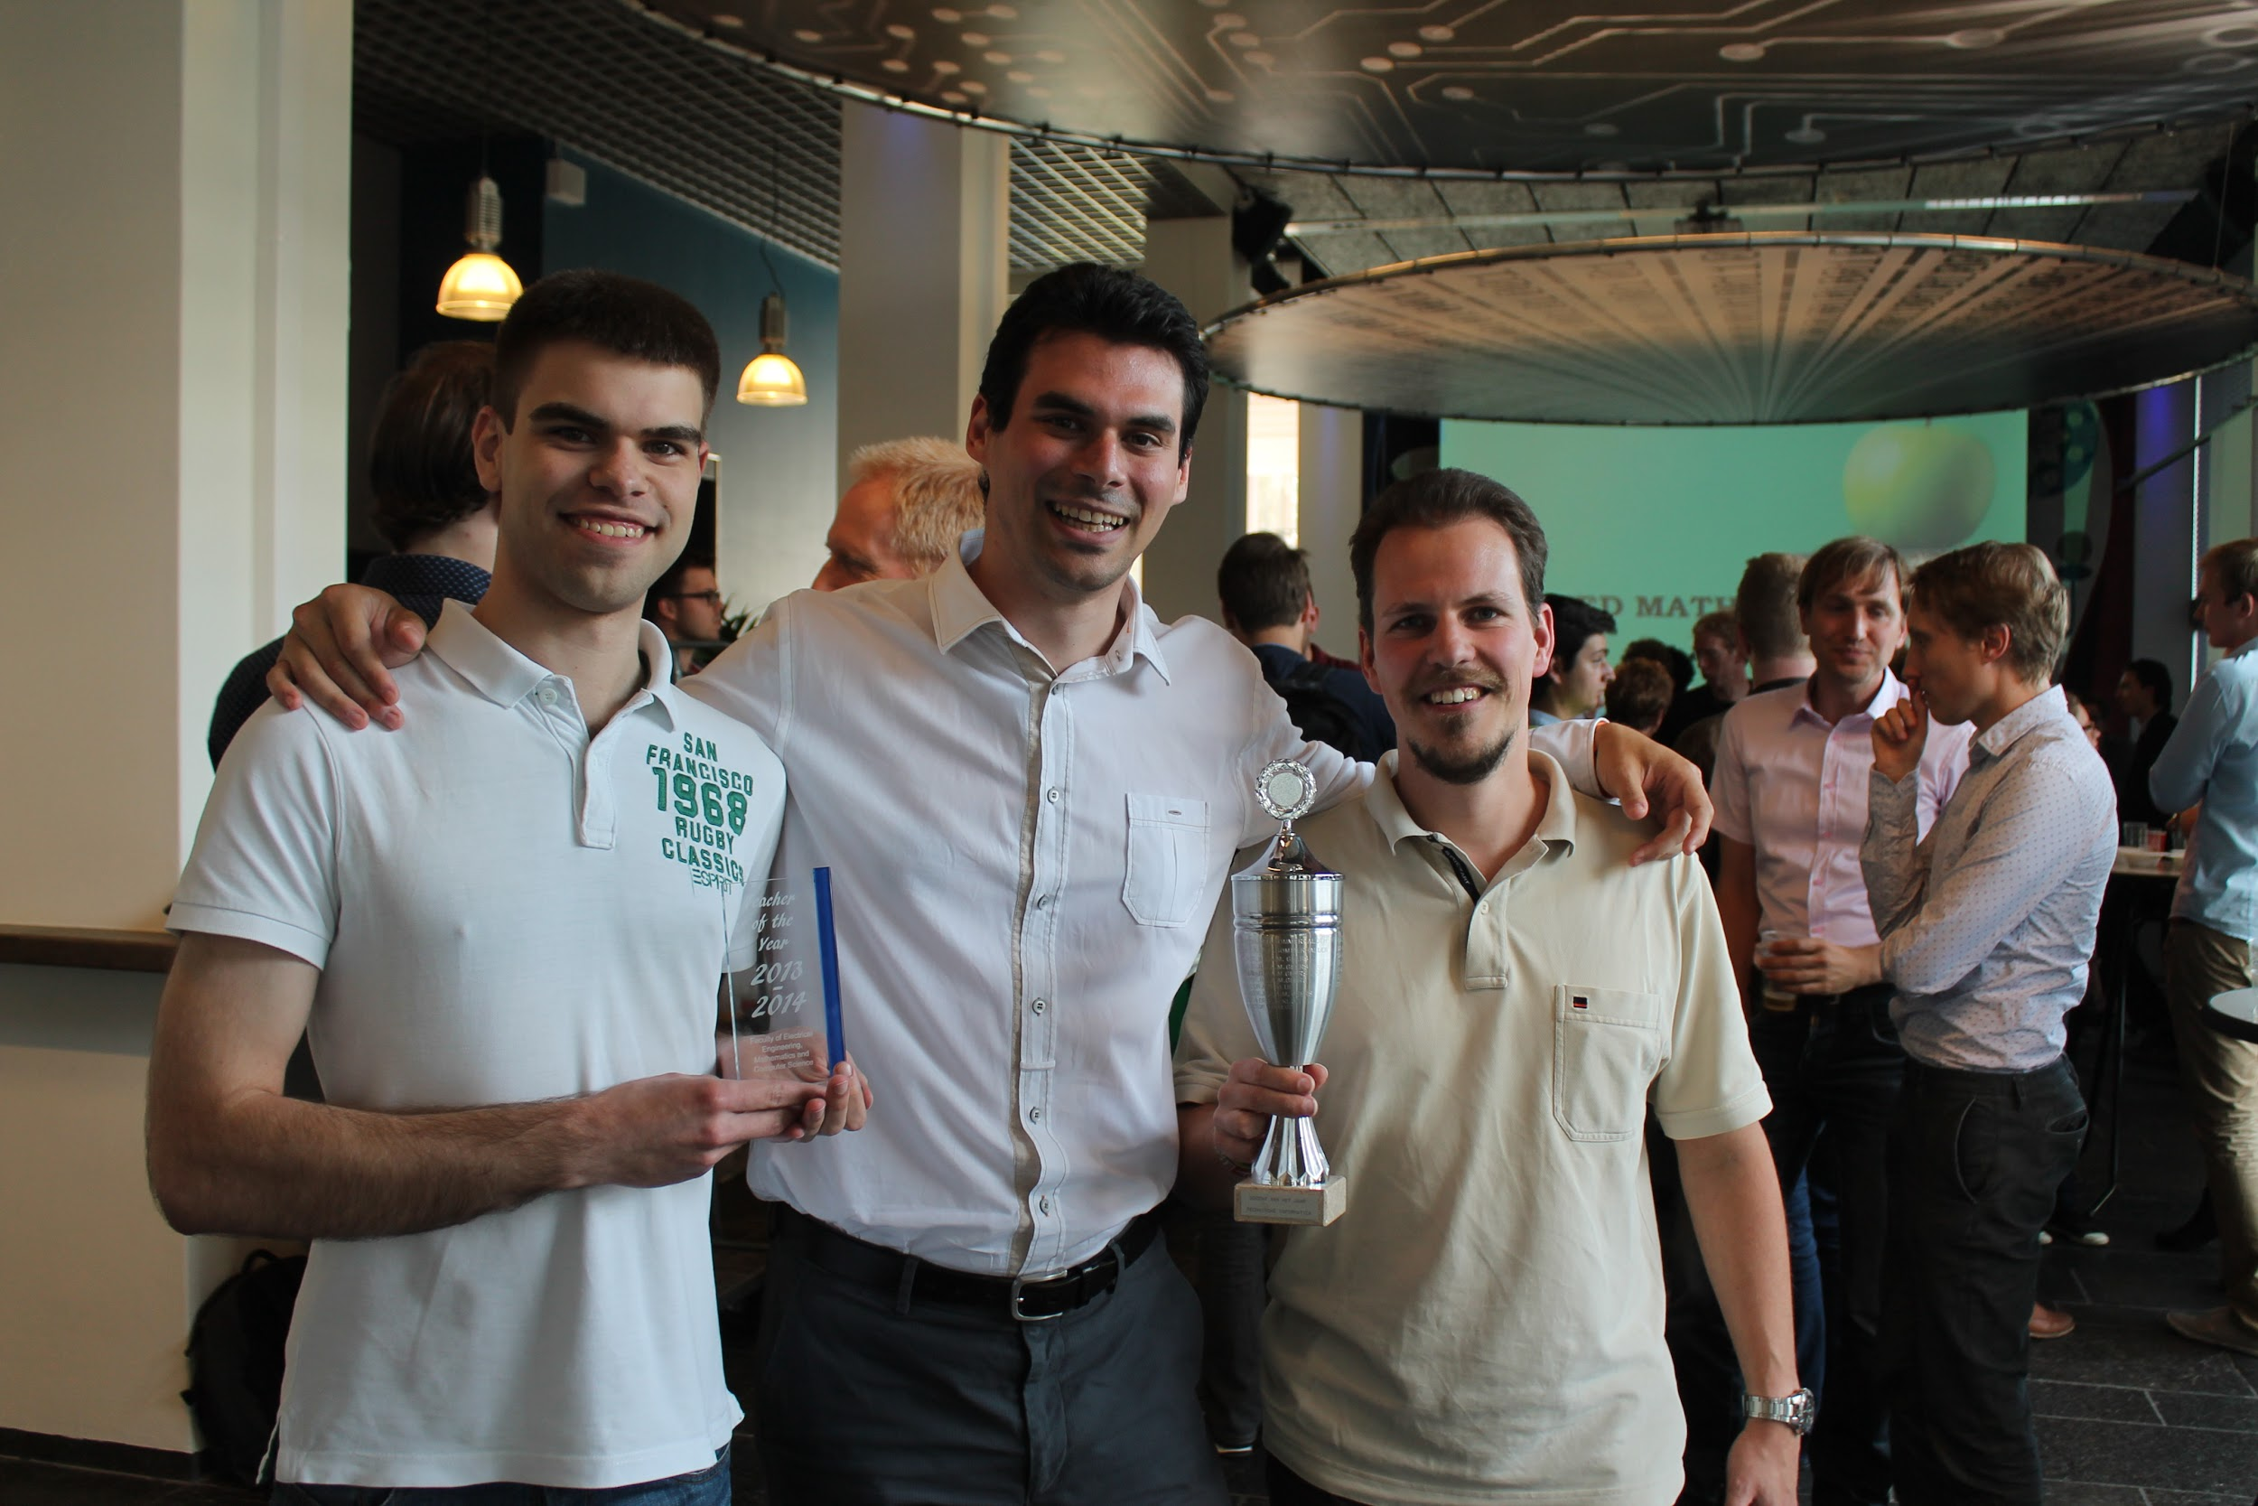
Notes:
Gamification works, students like it.

Slide 15
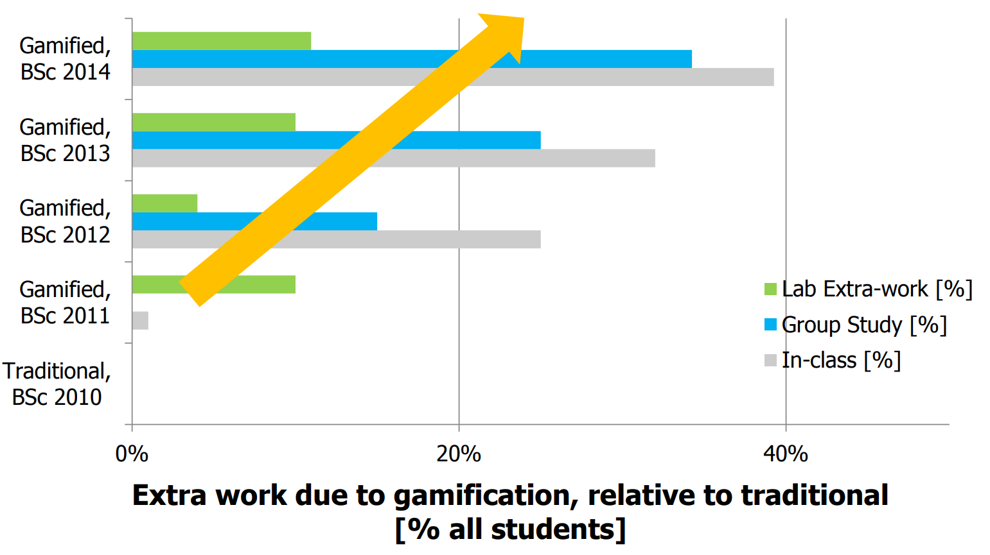
Source: https://atlarge-research.com/Presentations/2017/2017-02-03_GamificationWorks17tue.pdf
Notes:
Gamification works, students do more.

Slide 17
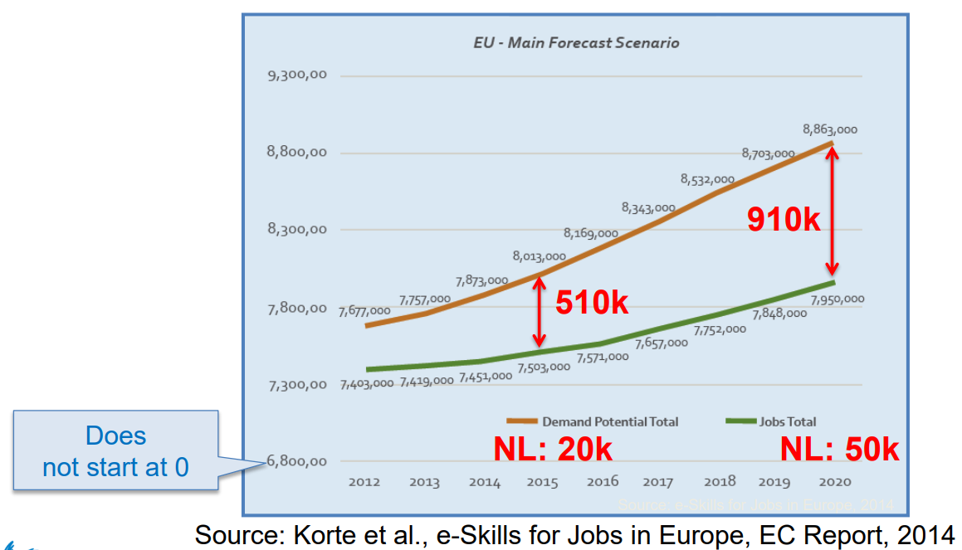
Notes:
But there are challenges ahead

Slide 18
Traditional course design
Assignments and exams calibrated to pass the average student.
Week 1
Week 2
Week 3
Week 4
Week 5
Week 6
Week 7
Week 8
time
Notes:
What do you want to offer in your course

Slide 19
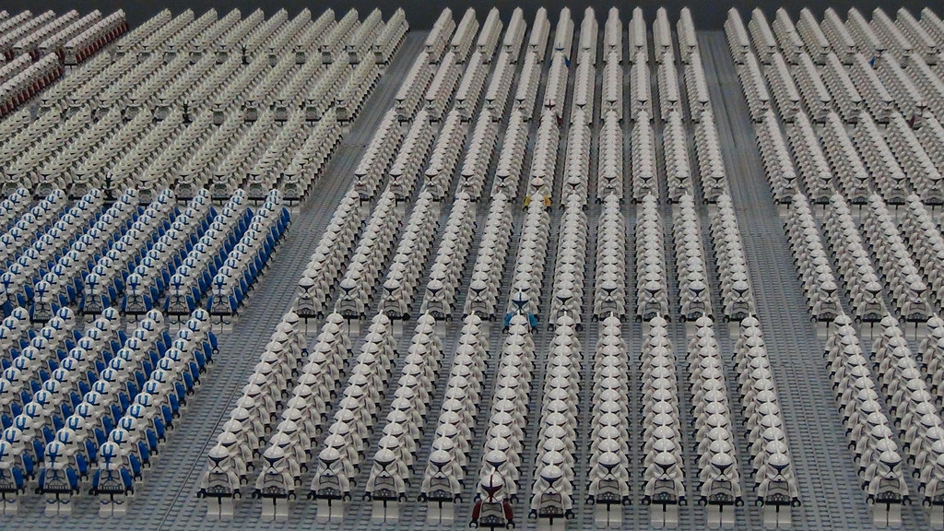
Notes:
Gamification is vulnerable to large classrooms. How to cope?

Slide 20



Current solutions are instruments.
Notes:
How to cope? 1. Better tools. Not the blackboard, brightspace, canvas, bs that there is now.
2. More teachers. Teaching seems inherently unscalable.

Slide 21
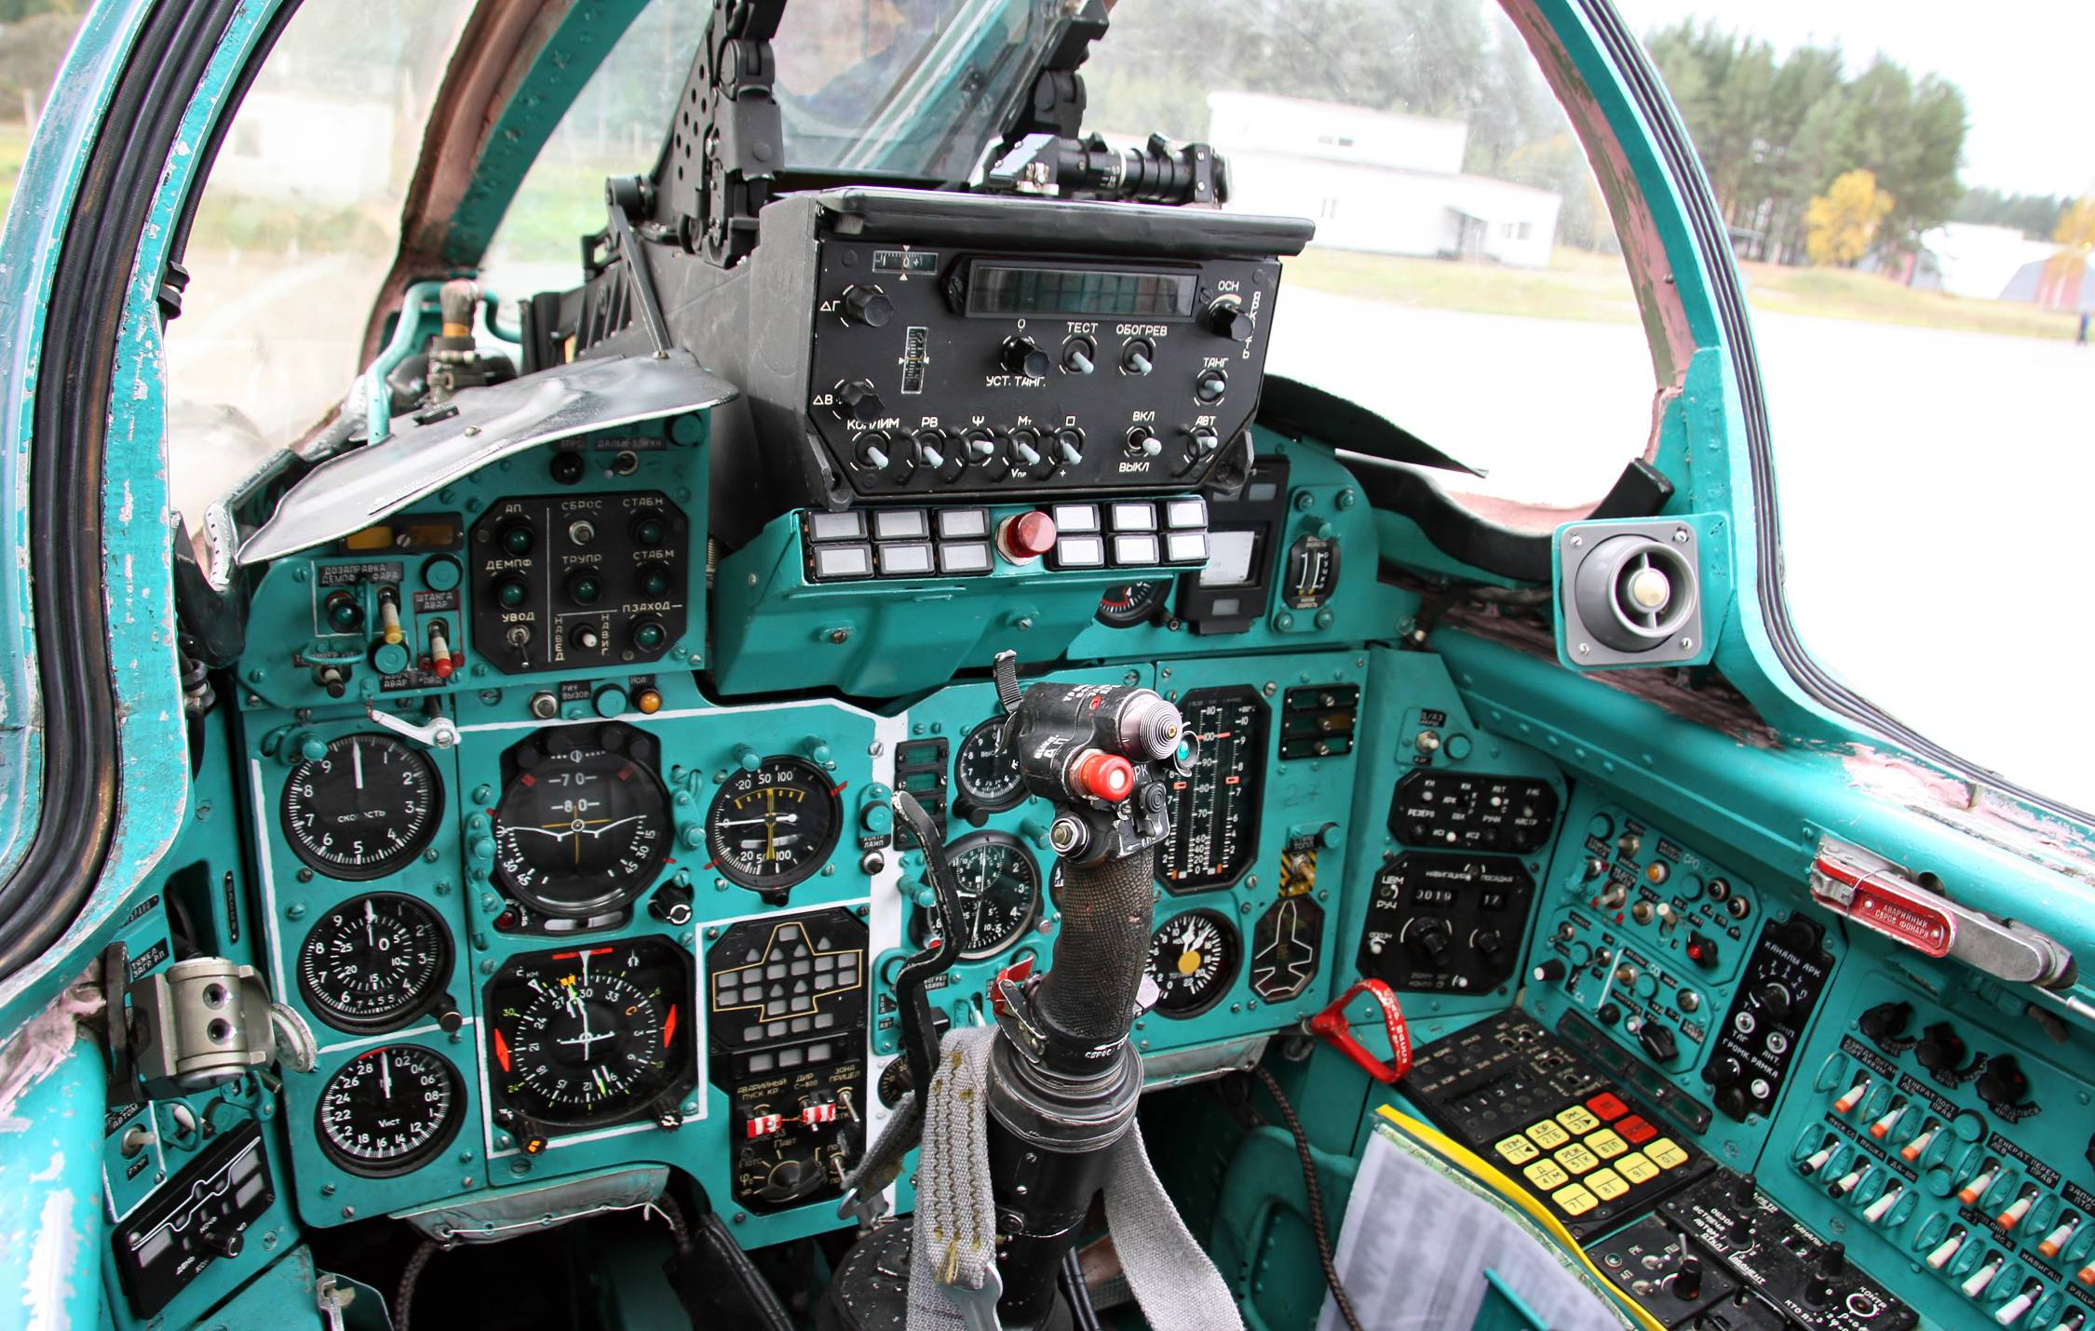

Slide 22
Current solutions are instruments.
Notes:
How to cope? 1. Better tools. Not the blackboard, brightspace, canvas, bs that there is now.
2. More teachers. Teaching seems inherently unscalable.

Slide 23
Current solutions are instruments.
We need tools.
Notes:
How to cope? 1. Better tools. Not the blackboard, brightspace, canvas, bs that there is now.
2. More teachers. Teaching seems inherently unscalable.

Slide 24
We need more teachers!

Slide 25
Higher Education in Computer Systems
Using gamification to train the next generation computer scientists
Jesse Donkervliet
Twitter: @jdonkervliet
Email: J.Donkervliet@atlarge-research.com

Slide 26
Higher Education in Computer Systems
Using gamification to train the next generation computer scientists
Jesse Donkervliet
Twitter: @jdonkervliet
Email: J.Donkervliet@atlarge-research.com

Slide 27
Higher Education in Computer Systems
Using gamification to train the next generation computer scientists
Jesse Donkervliet
Twitter: @jdonkervliet
Email: J.Donkervliet@atlarge-research.com

Slide 28
Lectures
Lab assignments
Which activities to include in your course?
Group assignments
Homework
Notes:
2 questions: who do you want to train? What activities do you offer?

