Slide 1
Experimental Computer Science: Focus on Workloads
Dror Feitelson
Berthold Badler chair in Computer Science
The Hebrew University of Jerusalem

Slide 2
Computer Science
Two major branches:
Theoretical
Complexity theory
Algorithms
Mathematical proofs
“Experimental”
Build systems
Both infrastructure and applications
Need precise definitions
Focus on worst case
Usually toy systems
Existence proof: not (always) generalizable

Slide 3
Experimental Science
Empirical research
Based on observation or experience
Provide real-world grounding
As opposed to pure theory and logic
Controlled experiments
Experiment = ask Nature a question
Controlled conditions ⇨ a focused question
May lead to unexpected discoveries

Slide 4
Computer Science (take 2)
Three major branches:
Theoretical
Complexity, algorithms, proofs
Experimental
Study man-made systems
Also study humans (HCI, SE)
Engineering
Build systems and applications
Try to influence industry
Worst case
Average case
Distributions
Good case(s)

Slide 5
Performance Evaluation
“Experimental computer science at its best” [Denning]
Major element of systems research
Compare design alternatives
Tune parameter values
Assess capacity requirements
Very good when done well
Very bad when not
Miss missions objectives
Waste of resources

Slide 6
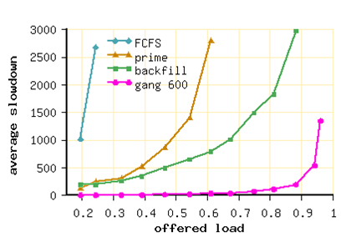
The Good Old Days…
The skies were blue
The simulation results were conclusive
Our scheme was better than theirs
Feitelson & Jette, JSSPP 1997

Slide 7
But in their papers,
Their scheme was better than ours!

Slide 8
How could they be so wrong?

Slide 9
Workload = Input
Algorithms
Systems
Worst case time/space
bounds
Input
instance
Algorithm
If you design a system with a certain workload in mind,
It will be good for that workload,
But not for other workloads
Average response-time /throughput metrics
Workload
System

Slide 10
Representativeness
Evaluation workload has to be representative of real production workloads
Achieved by using the workloads on existing systems
Analyze the workload and create a model
Use workload directly to drive a simulation

Slide 11
So Let’s Talk Workloads
Unexpected discoveries
Correlation of job size with runtime
Workload flurries
Challenges
How to get realistic workloads for evaluations
Resampling with feedback
Generative user-based workloads
A new paradigm for using workload data

Slide 12
correlations
Unexpected Discovery:

Slide 13
Scheduling Parallel Jobs
Each job gets a dedicated partition for the duration of its execution
Resembles 2D bin packing
Packing large jobs first should lead to better performance
Small jobs fit in the cracks
But what about correlation of size and runtime?

Slide 14
Scaling Models
Constant work
Parallelism for speedup: Amdahl’s Law
Large first ≈ SJF
Constant time
Size and runtime are uncorrelated
Memory bound
Large first ≈ LJF
Full-size jobs lead to blockout
No amount of theorizing can say which model is correct
Worley, SIAM JSSC 1990

Slide 15
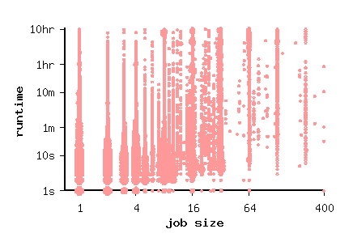
The Data
Data: SDSC Paragon, 1995/6

Slide 16
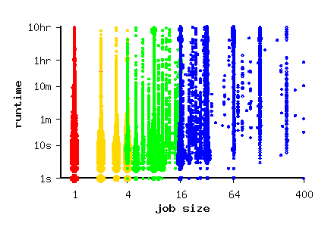
The Data
Data: SDSC Paragon, 1995/6

Slide 17
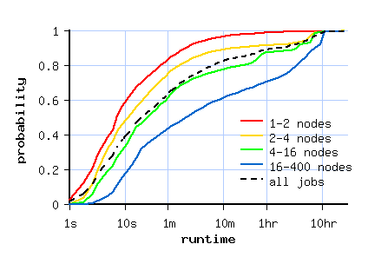
The Data
Data: SDSC Paragon, 1995/6

Slide 18
Conclusion
Parallelism used for better results, not for faster results
Constant work model is unrealistic
Memory bound model is reasonable
Scheduling algorithms that assume large jobs are short will probably not perform well in practice

Slide 19
flurries
Unexpected Discovery:

Slide 20
Workload Flurries
Bursts of activity by a single user
Lots of jobs
All these jobs are small
All of them have similar characteristics
Limited duration (day to weeks)
Flurry jobs may be affected as a group, leading to potential instability (butterfly effect)
Problem in simulations worse than in reality
Tsafrir & Feitelson, IPDPS 2006

Slide 21
Workload Flurries

Slide 22
Instability Example
Simulate scheduling of parallel jobs with EASY scheduler
Use CTC SP2 trace as input workload
Change load by systematically modifying inter-arrival times
Leads to erratic behavior

Slide 23
Instability Example
Simulate scheduling of parallel jobs with EASY scheduler
Use CTC SP2 trace as input workload
Change load by systematically modifying inter-arrival times
Leads to erratic behavior
Removing a flurry by user 135 solves the problem

Slide 24
To Clean or Not to Clean?
NO WAY!
Abnormalities and flurries do happen
Cleaning is manipulating real data
If you manipulate data you can get any result you want
This is bad science
DEFINITELY!
Abnormalities are unique and not representative
Evaluations with dirty data are subject to unknown effects
Do not reflect typical system performance
This is bad science
Feitelson & Tsafrir, ISPASS 2006

Slide 25
My Opinion
The virtue of using “real” data is based on ignorance
Must clean data of known abnormalities
Must justify the cleaning
Must report on what cleaning was done
Need research on workloads to know what is typical and what is abnormal
Use separate evaluations on the effects of abnormalities

Slide 26
Challenges

Slide 27
Using Accounting Logs
In simulations, logs can be used directly to generate the input workload
Jobs arrive according to timestamps in the log
Each job requires the number of processors and runtime as specified in the log
Used to evaluate new scheduler designs
Current best practice
Includes all the structures that exist in real workloads
Even if you don’t know about them!

Slide 28
PWA Usage Statistics
Cumulative citations in Google Scholar

Slide 29
Workloads
users
scheduler
jobs
parallel system in
production use

Slide 30
Workloads
users
scheduler
jobs
parallel system in
production use
accounting
logs
Parallel Workloads Archive
www.cs.huji.ac.il/labs/parallel/workload
Grid Workloads Archive
gwa.ewi.tudelft.nl

Slide 31
Using Workload Logs
simulated
log
scheduler
jobs
performance results

Slide 32
Using Workload Logs
simulated
log
scheduler
realism
jobs
inflexible
performance results
statistical
model
flexibility
synthetic
jobs
lose details

Slide 33
But…
Logs provide only a single data point
Logs are inflexible
Can’t adjust to different system configurations
Can’t change parameters to see their effect
Logs may require cleaning
Logs are actually unsuitable for evaluating diverse systems
Contain a “signature” of the original system

Slide 34
The “Signature”
A log reflects the behavior of the scheduler on the traced system
… and its interaction with the users
… and the users’ response to its performance
So there is no such thing as a “true workload”
Using a log to evaluate another scheduler may lead to unreliable results!
Shmueli & Feitelson, MASCOTS 2006

Slide 35
Example
Step 1: generate traces
FCFS – a simple scheduler that cannot support a high load
EASY – a more efficient backfilling scheduler
site-level dynamics
low load
users
FCFS
activity
site-level dynamics
high load
users
EASY
activity

Slide 36
Example
FCFS – a simple scheduler that cannot support a high load
EASY – a more efficient backfilling scheduler
site-level simulation
low load
users
FCFS
activity
site-level simulation
high load
users
EASY
activity

Slide 37
Example
Step 2: switch traces and use in regular simulation
FCFS – a simple scheduler that cannot support a high load
EASY – a more efficient backfilling scheduler
regular simulation
Overload!
low load
FCFS
activity
regular simulation
Too easy!
high load
EASY
activity

Slide 38
Independence vs. Feedback
Replaying a trace to recreate a workload assumes an open system model
Large user population insensitive to system performance
Jobs arrivals are independent of each other
But real systems are often closed
Limited user population
New jobs submitted after previous ones terminate
Leads to feedback from system performance to workload generation

Slide 39
Performance and Feedback
User behavior in response to performance
Generated jobs
as function of
response time
Similar to ecomonic supply-and-demand curves
Response time
Simulations and queueing theory
Performance as
function of load
Generated load
Notes:
Like equilibrium in economics supply and demand curves

Slide 40
Performance and Feedback
We want to compare systems “under the same conditions”
This usually means serving the same jobs
But if service is bad, users will give up
⇨ so there will be fewer jobs!
So there is no such thing as “the right jobs”
Instead, we need “the right users”

Slide 41
Simulations of Performance
Performance is inextricably related to user behavior
Performance evaluation requires models of how human users behave

Slide 42
User-based workloads

Slide 43
Effect of Users
Workload is generated by users
Human users do not behave like a random sampling process from a stationary distribution
Feedback based on system performance
Negative feedback
Better system stability
Repetitive working patterns

Slide 44
Locality of Sampling
Users display different levels of activity at different times
At any given time, only a small subset of users is active
These users repeatedly do the same thing
Workload observed by system is not a random sample from stationary distribution
This can be learned and exploited by a scheduler

Slide 45
User-Based Workloads
The workload on a multi-user system is composed of the workloads by multiple users
Turn this into a generative process:
Create individual job streams per user
Combine them
Add feedback from system performance

Slide 46
Benefits
Incorporate feedback from system performance
Daily cycle due to natural user activity
Locality due to different users with different job characteristics
Easy to include or exclude flurries
Heavy-tailed sessions lead to self similarity as exists in many workloads

Slide 47
Old Model
trace
data
scheduler
wait queue
Notes:
In evaluations also need to simulate user behavior!

Slide 48
Site-Level Model
user 1
job
job submission
stream
model
from log
scheduler
S
W
user N
wait queue
job
job submission
stream
model
from log
S
W
feedback
jobs
submit/wait
Shmueli & Feitelson, MASCOTS 2006
Notes:
In evaluations also need to simulate user behavior!

Slide 49
But where do we get
individual user data?

Slide 50
Resampling
Partition log into users (represented by their job streams)
Sample from the user pool
Combine job streams of selected users
Zakay & Feitelson, ICPE 2013

Slide 51
Resampling Benefits
Can change the number of users
More users ⇨ higher load
Less users ⇨ lower load
Resample more ⇨ create longer log ⇨ better simulation convergence
Create multiple statistically-similar workload instances ⇨ calculate confidence intervals
Combine data from many logs ⇨ improve representativeness
Flexibility without losing realism

Slide 52
User Behavior Model
Users work in sessions
If a job’s response time is short, there is a high probability for a short think time and an additional job
If a job’s response time is long, there is a high probability for a long think time
i.e. the session will end
A session may also end due to the daily cycle of activity

Slide 53
Analogy
Paxson and Floyd / difficulties in simulating the Internet
Packet traffic is easy to record, but
Depends on network conditions
And how TCP congestion control reacts to it
So need to generate workload at the source level (the application that sent the packets)
And add feedback effects in the simulation

Slide 54
The Mechanics of Feedback
If users perceive the system as loaded, they will submit less jobs
But what exactly do users care about?
Response time: how long they wait for results
Slowdown: how much longer than expected
Answer needed to create a user model that will react correctly to load conditions

Slide 55
Data
What causes users to abort their session?
Response time is a better predictor of subsequent behavior than slowdown
Shmueli & Feitelson, MASCOTS 2007

Slide 56
Data Mining
Available data: system accounting log
Need to assess user reaction to momentary condition
The idea: associate the user’s think time with the performance of the previous job
Good performance ⇨ satisfied user ⇨ continue work session ⇨ short think time
Bad performance ⇨ dissatisfied user ⇨ go home ⇨ long think time
“performance” = response time or slowdown

Slide 57
The Data
Similar average think time for widely different slowdowns
Differences between different logs
Slowdown is not a good predictor of user behavior

Slide 58
The Data
Think time depends strongly on response time
Very similar behavior in all logs
Response time is a good predictor of user behavior
(at least above 1 min.)

Slide 59
Resampling with Feedback
log
modeling
user
behavior

Slide 60
Resampling with Feedback
Same sequences of jobs
Timing adjusted based on performance
log
resampling
of users
user
behavior
simulated
model
scheduler
jobs
feedback
performance
results

Slide 61
Implications
Performance metrics change
Better scheduler ⇨ more jobs ⇨ higher throughput
Better scheduler ⇨ more jobs ⇨ maybe higher response time (considered worse!)
Feedback counteracts efforts to change load
Higher load ⇨ worse performance ⇨ users back off
Negative feedback effect
Leads to stability: system won’t saturate!

Slide 62
THIS IS DIFFERENT
Old School
New Idea
Fair evaluations require equivalent conditions
Equivalent conditions = same job stream
Retain jobs and timestamps from log (at possible expense of dependencies)
Fair evaluations require equivalent conditions
Equivalent conditions = same users with same behaviors
Retain logical structure of workload (dependencies & Feedback) at possible expense of timestamps

Slide 63
Conclusions
Representative workloads are important
But must be adjusted to the system under study
Can be done with resampling and feedback
Many benefits over just replaying a trace
A different mindset

Slide 64
Thank You
Students
Dan Tsafrir (PhD 2006)
Edi Shmueli (PhD 2008)
Netanel Zakay (PhD 2018)
Funding
Israel Science Foundation
Ministry of Science and Technology
Parallel Workloads Archive
CTC SP2 – Steven Hotovy and Dan Dwyer
SDSC Paragon – Reagan Moore and Allen Downey
SDSC SP2 and DataStar – Victor Hazelwood
SDSC Blue Horizon – Travis Earheart and Nancy Wilkins-Diehr
LANL CM5 – Curt Canada
LANL O2K – Fabrizio Petrini
HPC2N cluster – Ake Sandgren and Michael Jack
LLNL uBGL – Moe Jette

Slide 65
Thank You
Question and answer price list
Basic answers | $1
Answers that require thought | $2
Correct answers | $4
Sold
out!

