Slide 1
A Trace-Based Performance Study of Autoscaling Workloads of Workflows in Datacenters
Mihai Neacşu, BSc.
Prof.dr.eng. Alexandru Iosup
Ir. Laurens Versluis
Massivizing Computer Systems
@Large research, https://atlarge-research.com

Slide 2
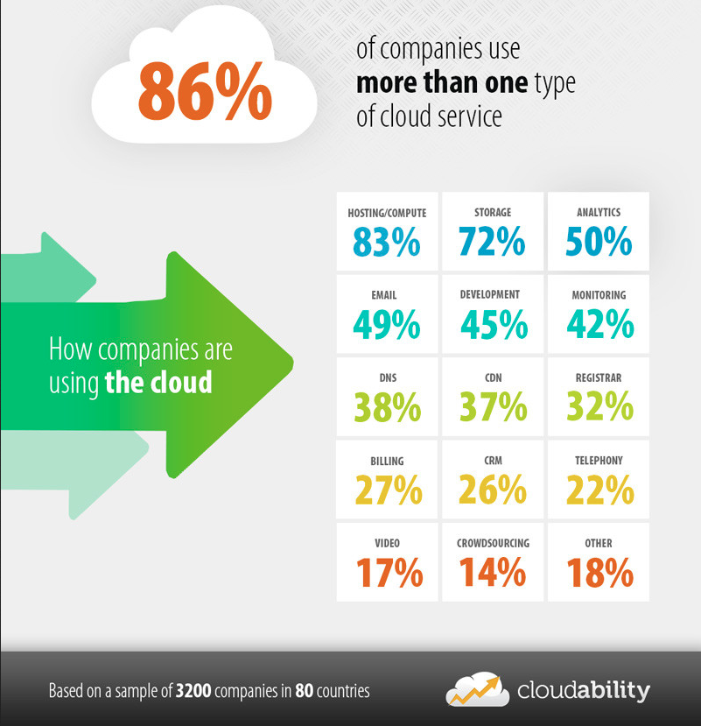
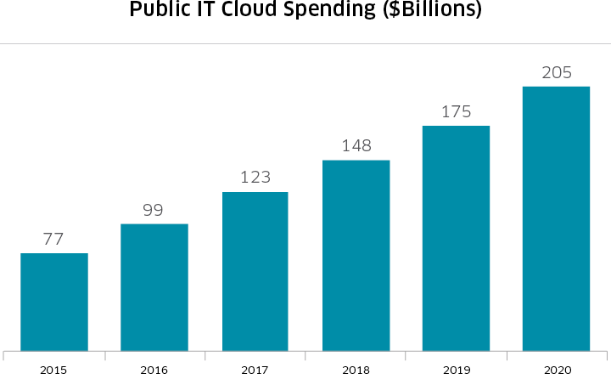
Cloud popularity and usage at all-time high
Surveys: >$200B market by 2020, 86% of companies use >1 cloud service
Resource utilization increasingly important
Competitive position for companies
Reduce costs for customer & provider
Source: http://business.nasdaq.com/marketinsite/2017/Cloud-Computing-Industry-Report-and-Investment-Case.html

Slide 3
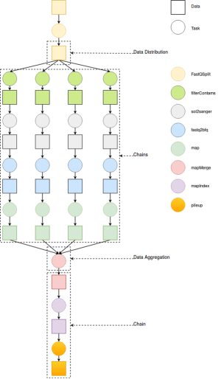
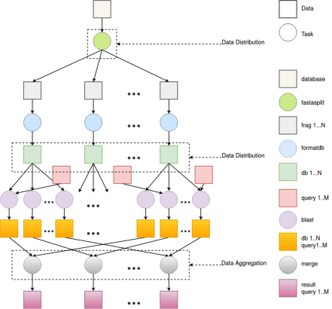
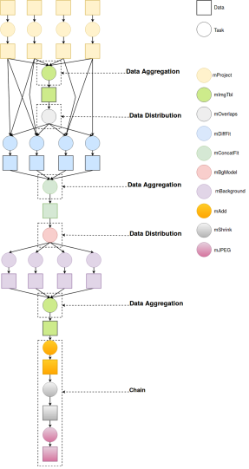
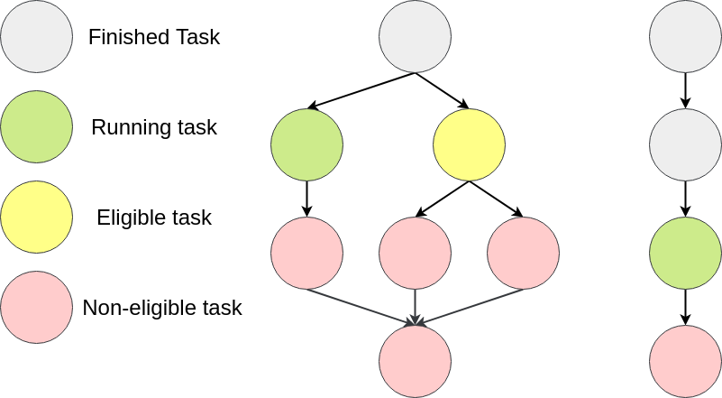
Workflow execution is gaining popularity
Workflows = set of tasks with precedence constraints
Usually represented as a Directed Acyclic Graph (DAG)
Used to model applications in many domains
Today: thousands of applications in use

Slide 4
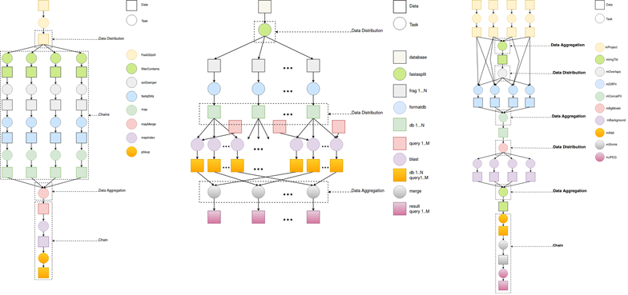
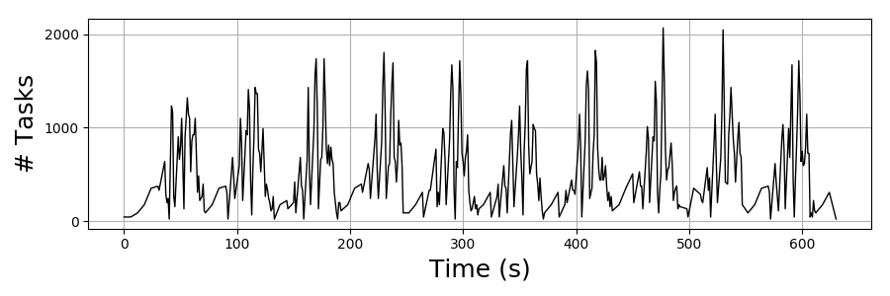
Executing workflows in the cloud
Workflows are submitted to the cloud, executed in datacenters
Workflow resource demand changes over time due to their complex structures
How many resources to acquire and when?
Workload of workflows

Slide 5
A problem for cloud providers
Minimize overprovisioning (allocating too many resources)
Reduces costs
Adhere to the Quality-of-Service (QoS) requirements of the client
Minimize underprovisioning
Automate this process
Poor user estimates of resource requirements
Solution: Autoscalers
Scale resources on demand
Forecast resource demand in the near-future
Deal with sudden flash-crowds/peaks

Slide 6
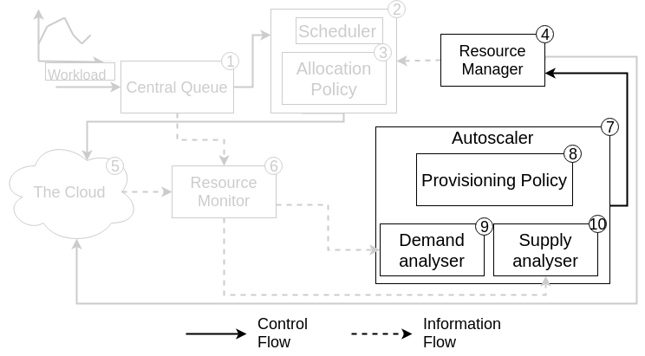
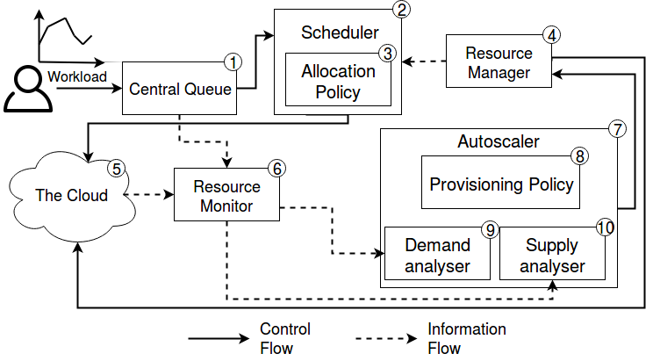
Autoscaler operations
Monitor current workload (9) and available resources (10)
Attempt to predict future utilization (8)
Scale resources up or down according to prediction (4)
How well do autoscalers perform relative to each other?

Slide 7
In this work: Compare autoscalers in simulation
Four distinct workload traces
A workload is a set of workflows (applications)
Use a rich set of metrics
10+ forms of elasticity
Four experiments
Different workload domains (new)
Bursty workloads (deeper understanding)
Impact of the allocation policy (new)
Different resource environments (new)
Medium scale
Notes:
Definitely mention that our design, we have contacted the authors of a previous work that performa real-world experimentation and obtained their dataset. We have verified our output matches theirs and added several

Slide 8
The seven autoscalers
Reg
Employs a predictive component using second-order regression
Adapt
Predicts workload based on the slope of the curve of monitored load
Hist
Predicts workload based on an hour-based histogram of past load
React
Changes resources when a certain threshold has been reached
ConPaaS
Scales resource based on past observed throughput. Uses several time series analysis techniques such as Linear Regression etc.
Token
Estimates the level of parallelism and allocates resources based on this number
Plan
Constructs partial execution plans for running and eligible jobs by exploiting workflow structure and estimating task runtimes

Slide 9
Experiment: different workload domains
Investigate the performance of autoscalers while processing workloads of different domains
Three workloads:
Scientific (T1)
Industrial (T2)
Engineering (T3)
Use the Chronos (Shell) industrial resource setup
70 resources per cluster
At start, the number of clusters is scaled to reach 70% resource utilization

Slide 10
Results: significant differences per domain
For some metrics such as overprovisioning, ConPaaS and Hist perform worse for the EE workload
Autoscalers underprovision roughly equally on all workloads
Notes:
Make backup slide with all formulas of the metrics Maak twee bargraphs die je laat zien. + Vertel grapje “don’t worry, there are charts”.

Slide 11
Experiment: bursty workloads
Inspect the performance of autoscalers when handling bursty workloads
Two workloads:
Scaled version of the Industrial trace (T2) to match T4
Engineering (T4)
T4 features a one-time burst of ~24,000 tasks in the first minute
Use the Chronos (Shell) industrial setup
70 resources per cluster
At start, the number of clusters is scaled to reach 70% resource utilization
Metrics
Cumulative task delay
Workload makespan (M)

Slide 12
Results
Results for the scaled Industrial workload (T2)

Slide 13
Experiment: different allocation policies
Inspect the performance of autoscalers using different allocation policies
One workload:
Engineering (T4)
Three allocation policies
WorstFit
FillWorstFit
BestFit
Use the Chronos (Shell) industrial setup
70 resources per cluster
At start, the number of clusters is scaled to reach 70% resource utilization
Metrics
Supplied resources
Notes:
We expect the results to be different, as for BestFit the number of allocated resources may be lower, which some autoscalers take into account. So we would expect differences.

Slide 14
Results
Token overestimates the level of parallelism and oversupplies
BestFit has a significant better performance than the other two policies
Conclusion: the allocation policy has a direct impact on the performance. Suggests co-designing allocation and provisioning policies.
Notes:
Add callout why fillworstfit and worstfit are at 280 (because idle clusters receive 1 task continuously and cannot be deallocted).

Slide 15
Experiment: different resource environments
Inspect the performance of autoscalers using different allocation policies
One workload:
Engineering (T4)
Three allocation policies
WorstFit
FillWorstFit
BestFit
Use the Chronos (Shell) industrial setup
70 resources per cluster
At start, the number of clusters is scaled to reach 70% resource utilization
Metrics
Cumulative task delay
Normalized Schedule length (NSL)
Workload makespan (M)

Slide 16
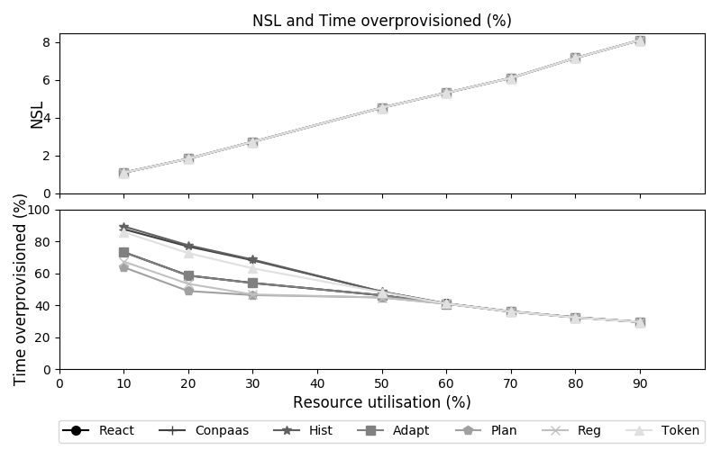
Results
Hist, ConPaaS and Token overprovision more while yielding no NSL benefit

Slide 17
Conclusion and future work
We compared seven autoscalers using four distinct traces
In this work four experiments:
The performance differs significantly per application domain
The allocation policy has a direct impact on performance
All autoscalers perform similar on bursty workloads in terms of NSL
Some autoscalers overprovision more while yielding no better NSL
Future work:
Study the impact of heterogeneity
Apply several cost metrics by using e.g. cost models
Experiment with job and task migrations
Improve our simulations by including resource boot-up times
Interested in the other two experiments or the paper? Let me know!
Notes:
The performance differs significantly per application domain
All autoscalers perform similar on bursty workloads in terms of NSL
The allocation policy has a direct impact on performance
Suggests to co-design allocation and provision policies
Some autoscalers overprovision more while yielding no better NSL

Slide 18
A Trace-Based Performance Study of Autoscaling Workloads of Workflows in Datacenters
Mihai Neacşu, BSc.
Prof. Dr. Ir. Alexandru Iosup
Ir. Laurens Versluis
Massivizing Computer Systems
@Large research, https://atlarge-research.com

